Slide 1

Reconocimiento de Patrones
Domingo Mery
Departmento de Ciencia de la Computación
Escuela de Ingeniería
Universidad Católica de Chile
Deep Learning
[ Capítulo 4 ]

Slide 2
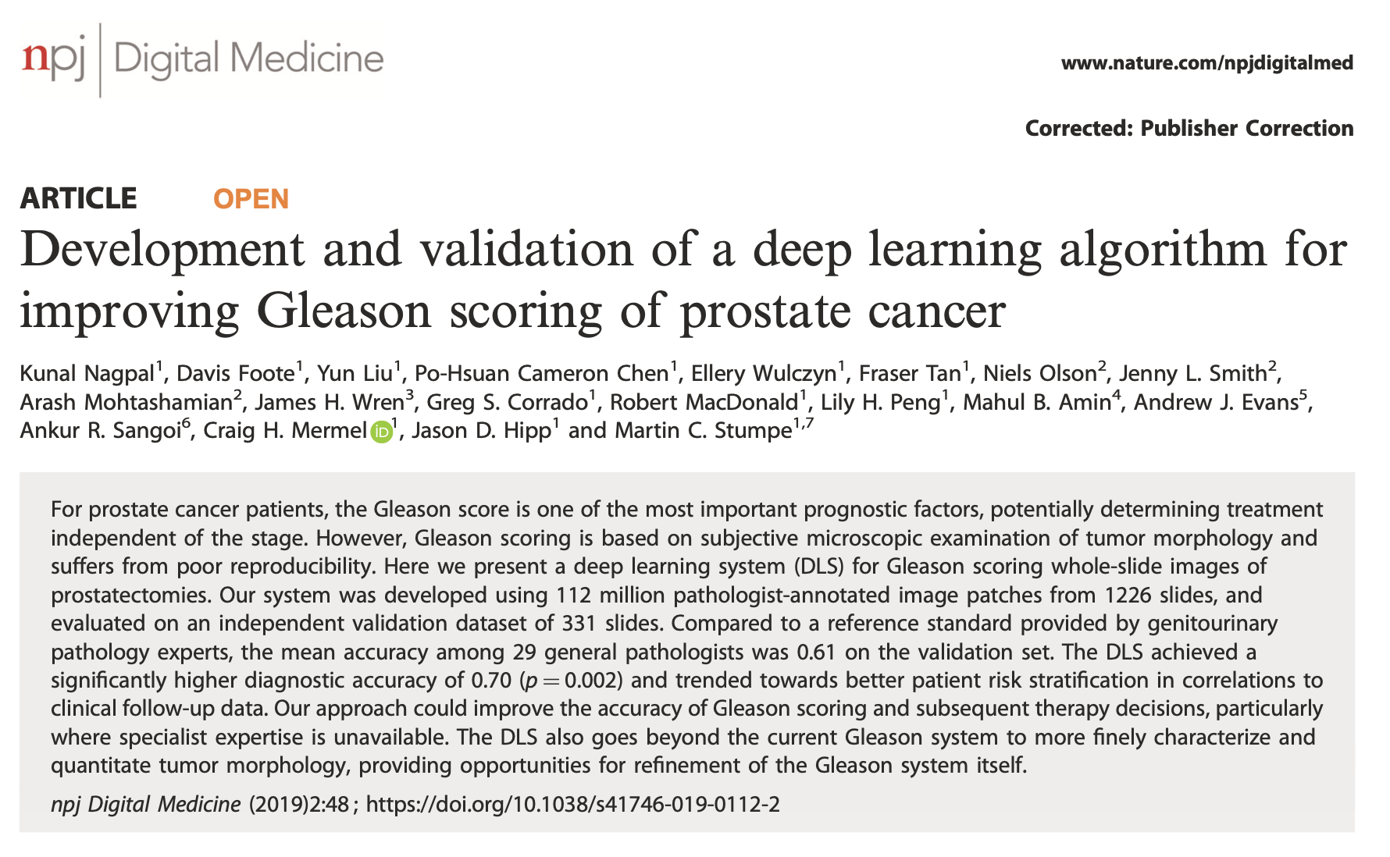
Diagnosis of Prostate Cancer
https://www.nature.com/articles/s41746-019-0112-2.pdf

Slide 3
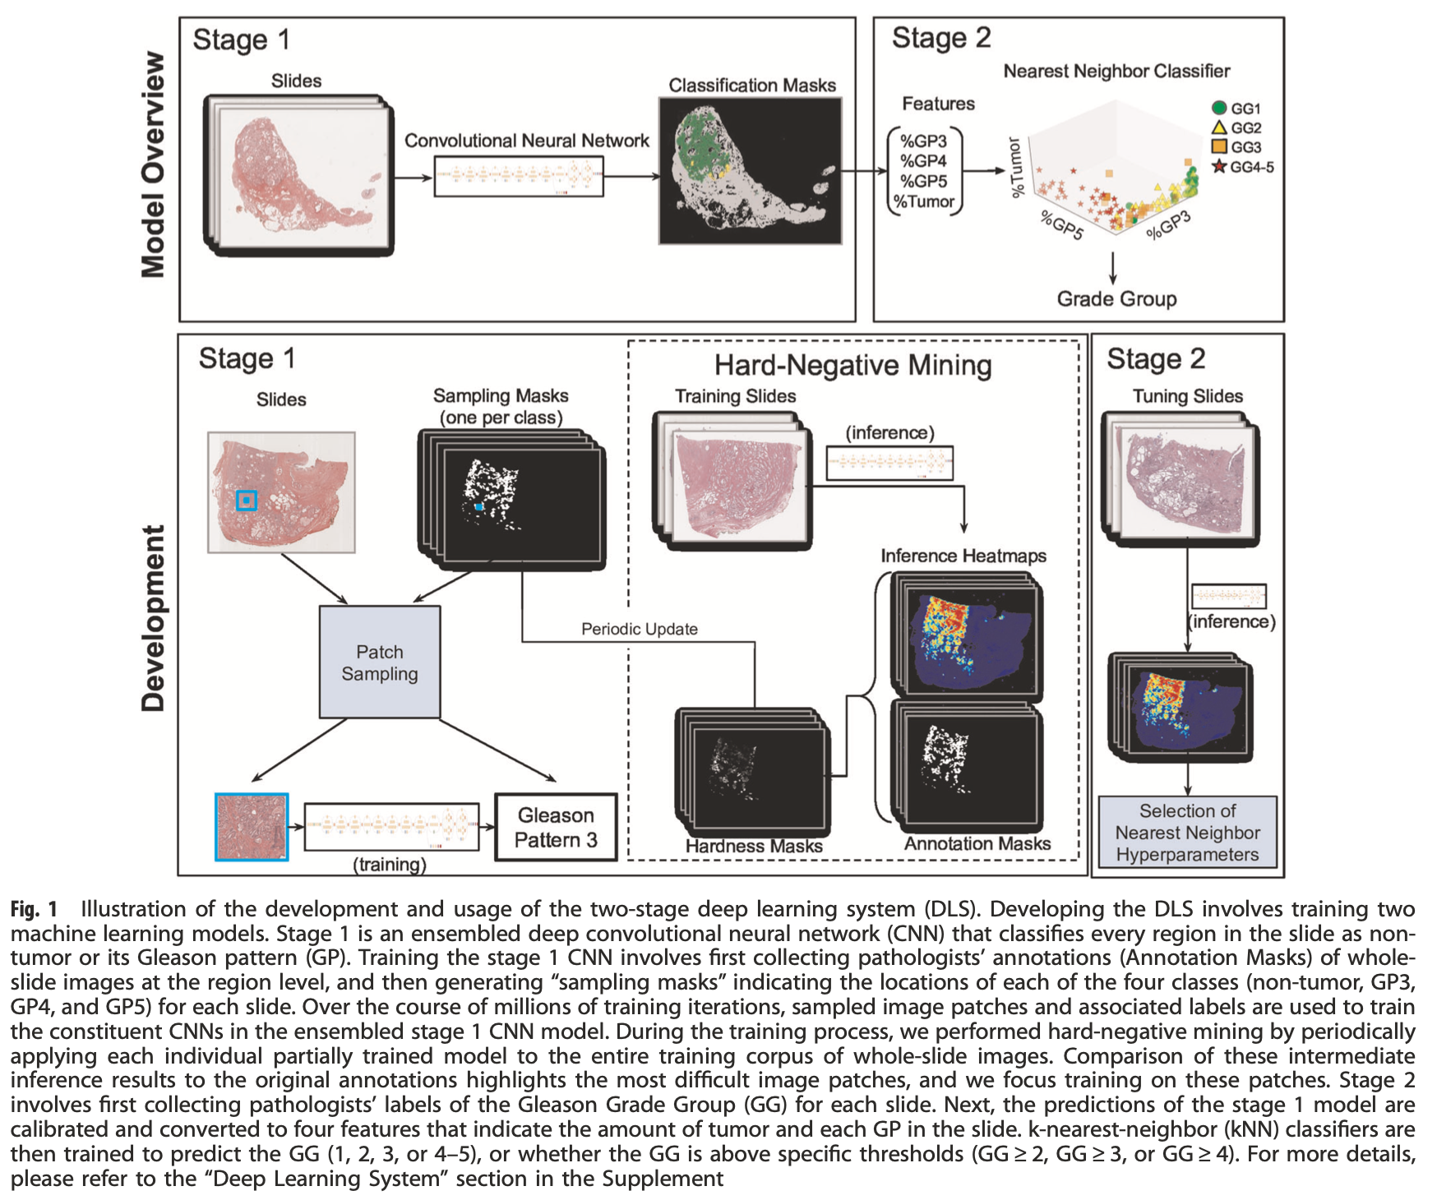
Diagnosis of Prostate Cancer

Slide 4
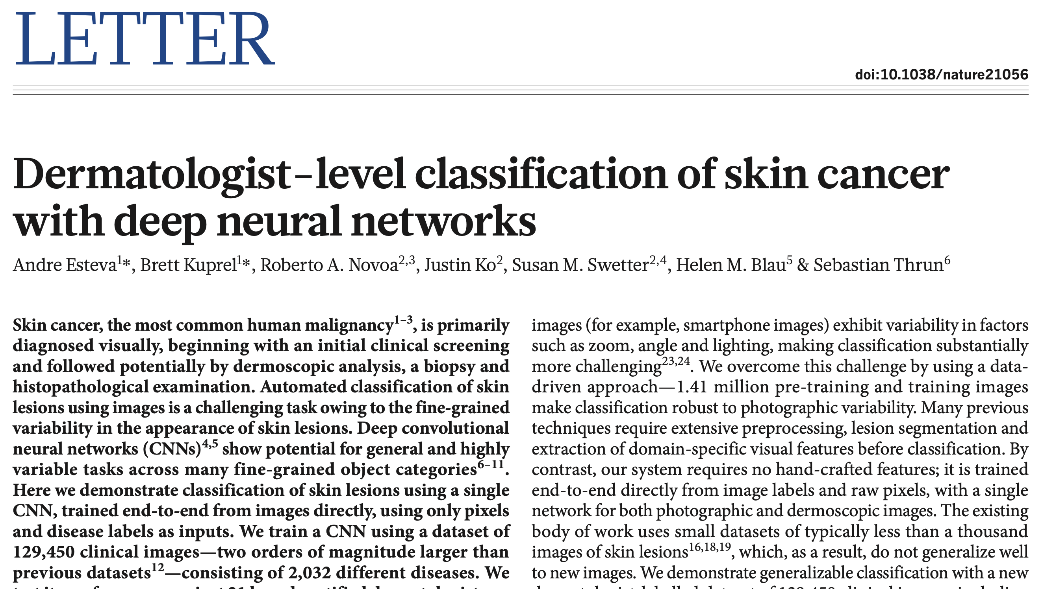
Skin Cancer Recognition
https://www.nature.com/articles/nature21056.pdf

Slide 5
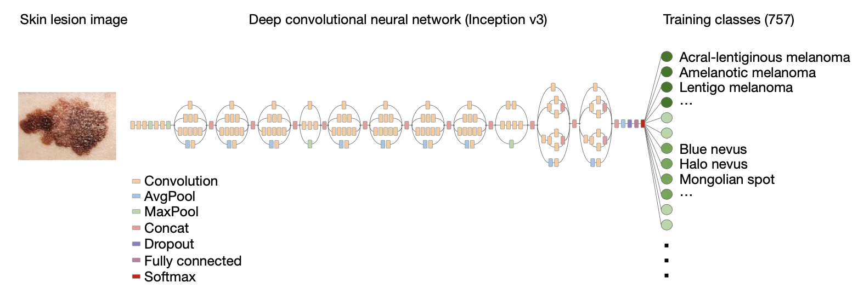
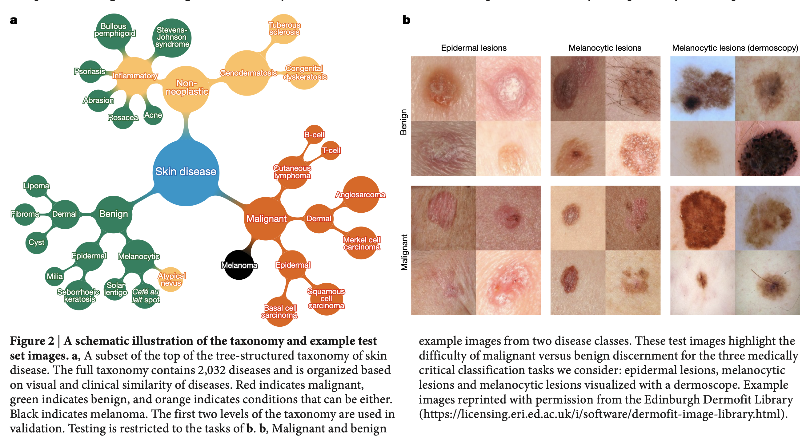
Skin Cancer Recognition

Slide 6
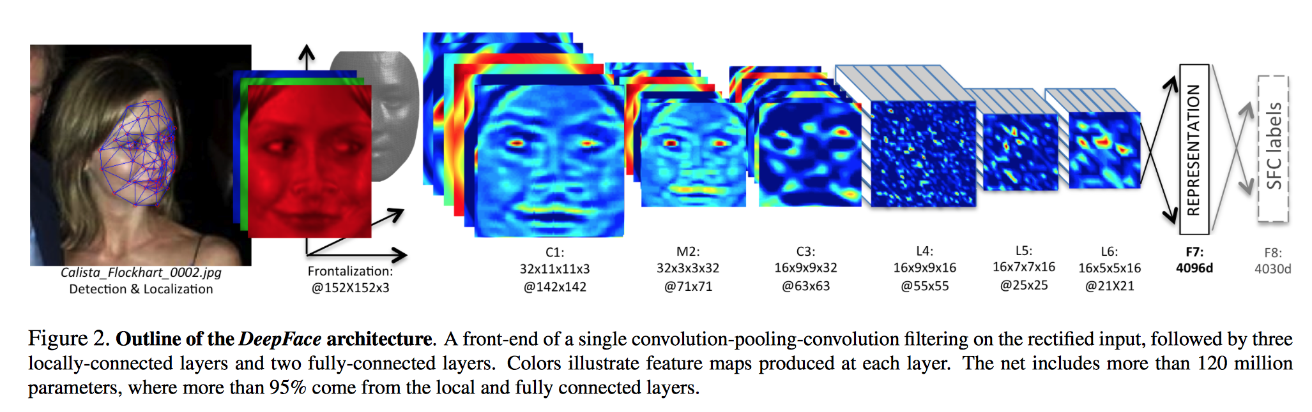
Face Recognition
Taigman, Yaniv, et al. "Deepface: Closing the gap to human-level performance in face verification." Proceedings of the IEEE Conference on Computer Vision and Pattern Recognition. 2014. [ PDF ]

Slide 7
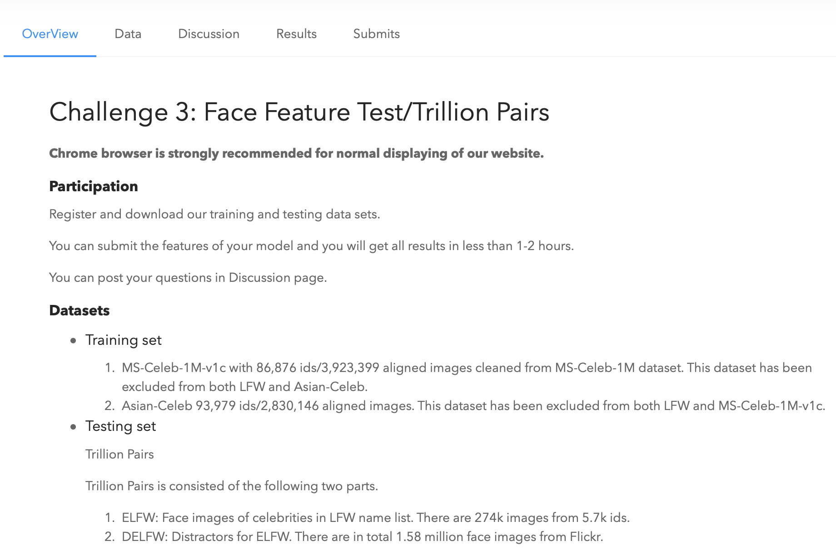
Face Recognition
http://trillionpairs.deepglint.com

Slide 8
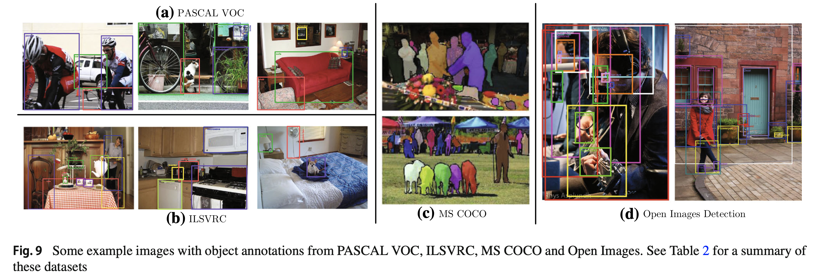
Object Detection
Liu, L., Ouyang, W., Wang, X., Fieguth, P., Chen, J., Liu, X., & Pietikäinen, M. (2020). Deep learning for generic object detection: A survey. International journal of computer vision, 128(2), 261-318.

Slide 9
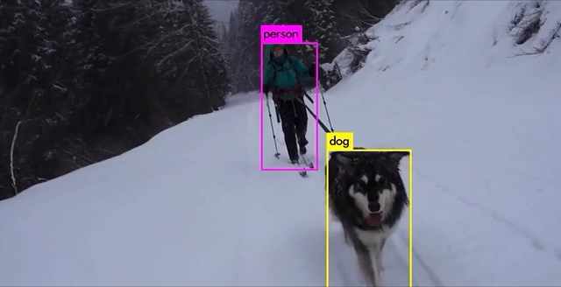
Object Detection
https://pjreddie.com/darknet/yolo/

Slide 10
Motivation

Slide 11
Images of different
known classes
Representation
Class 1
Feature Feature Design of
Extraction Selection Classifier
Class 2
Class n
Stage 1: TRAINING
Stage 2: TESTING
Extraction of
selected
features
InputA: Test Image
Class
Classification
Output:

Slide 12
MOTIVATION
Handcrafted vs. Learned features
LBP, Haralick, Fourier, Gabor, etc.
or
Learned representation from training data

Slide 13
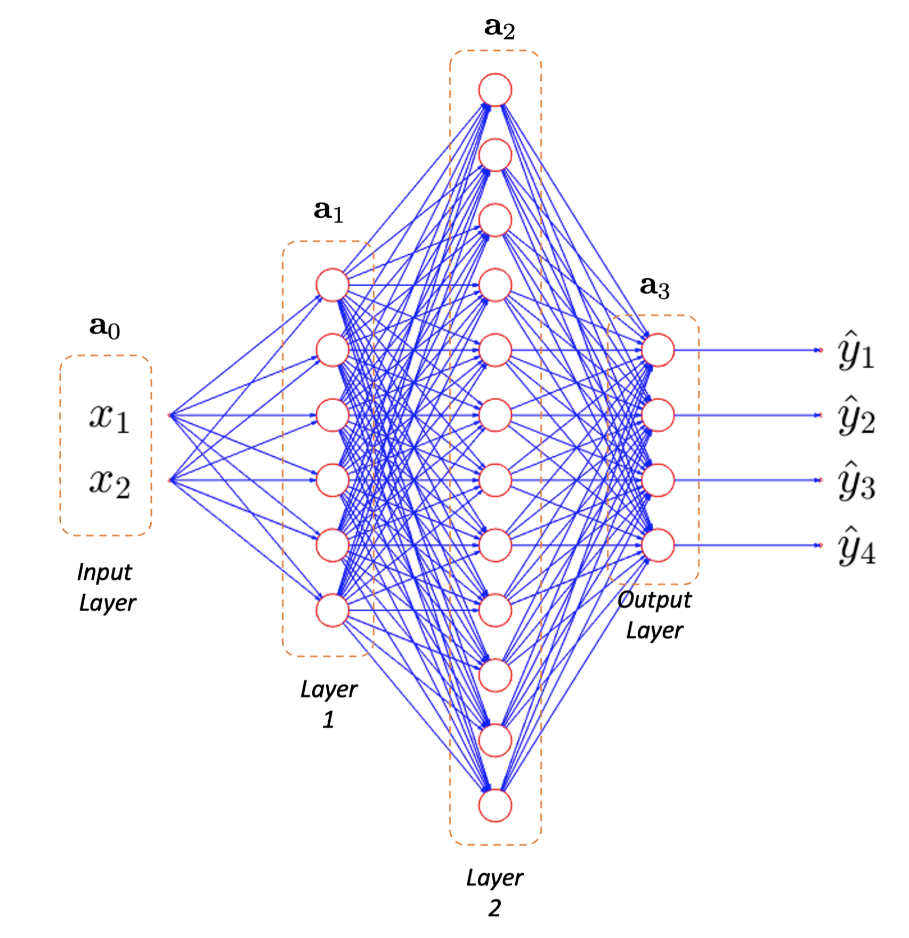
MOTIVATION
Neural networks

Slide 14
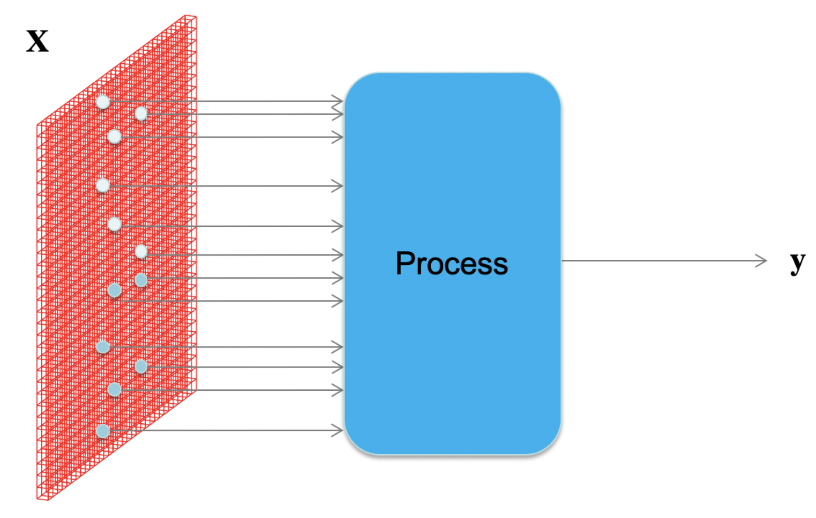
MOTIVATION
How to process an image with neural networks?

Slide 15
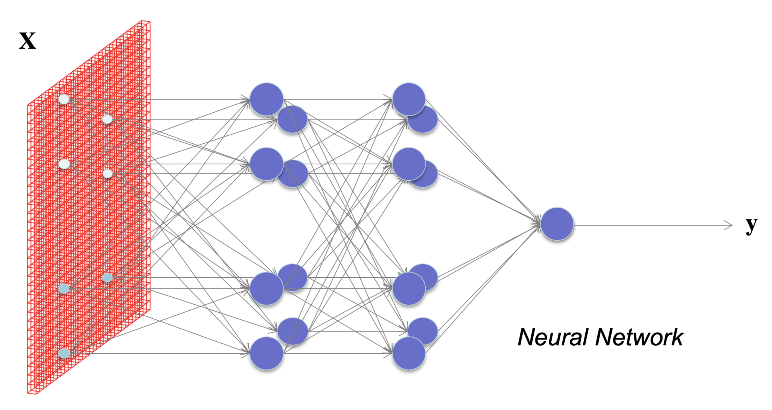

MOTIVATION
What happens if each pixel is an input?
How many neurons and weights?

Slide 16
Basics

Slide 17
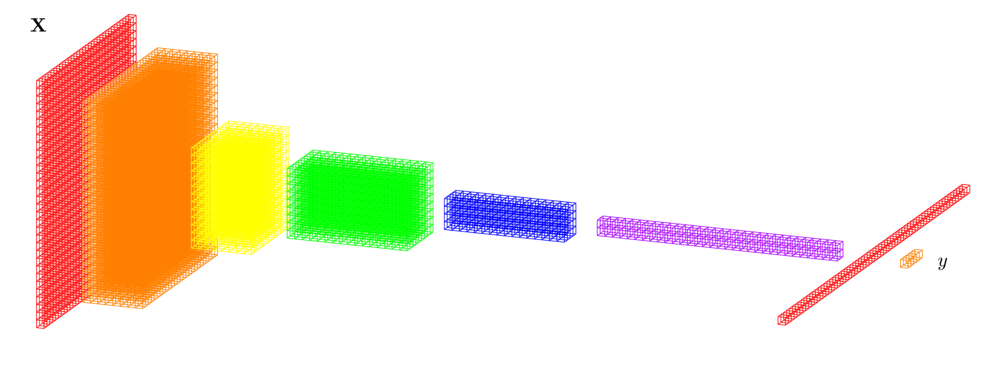
DEEP LEARNING BASICS (CNN)
Convolutional Neural Networks)
Data
representation
Input
image
Layers
Classification

Slide 18
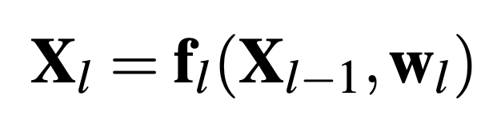
DEEP LEARNING BASICS (CNN)
Convolutional Neural Networks)
f₁
f₂
f₃
f₄
f₅
f₇
f₆
Input
image
Layers
Classification

Slide 19
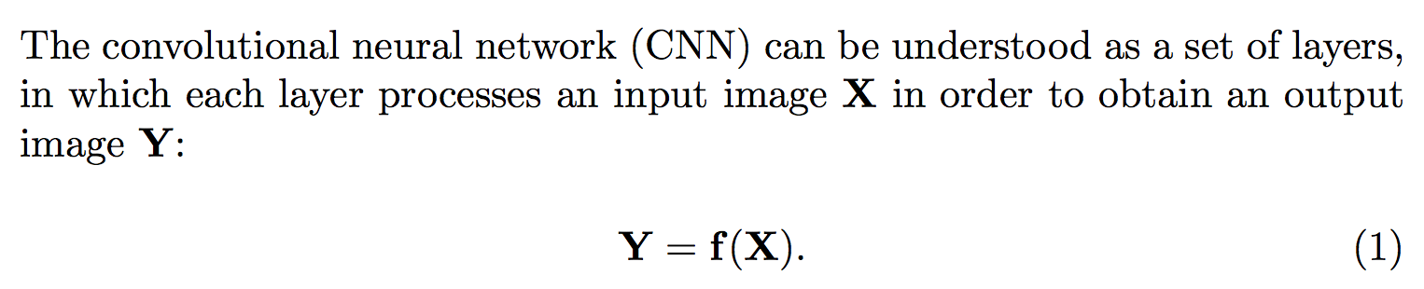
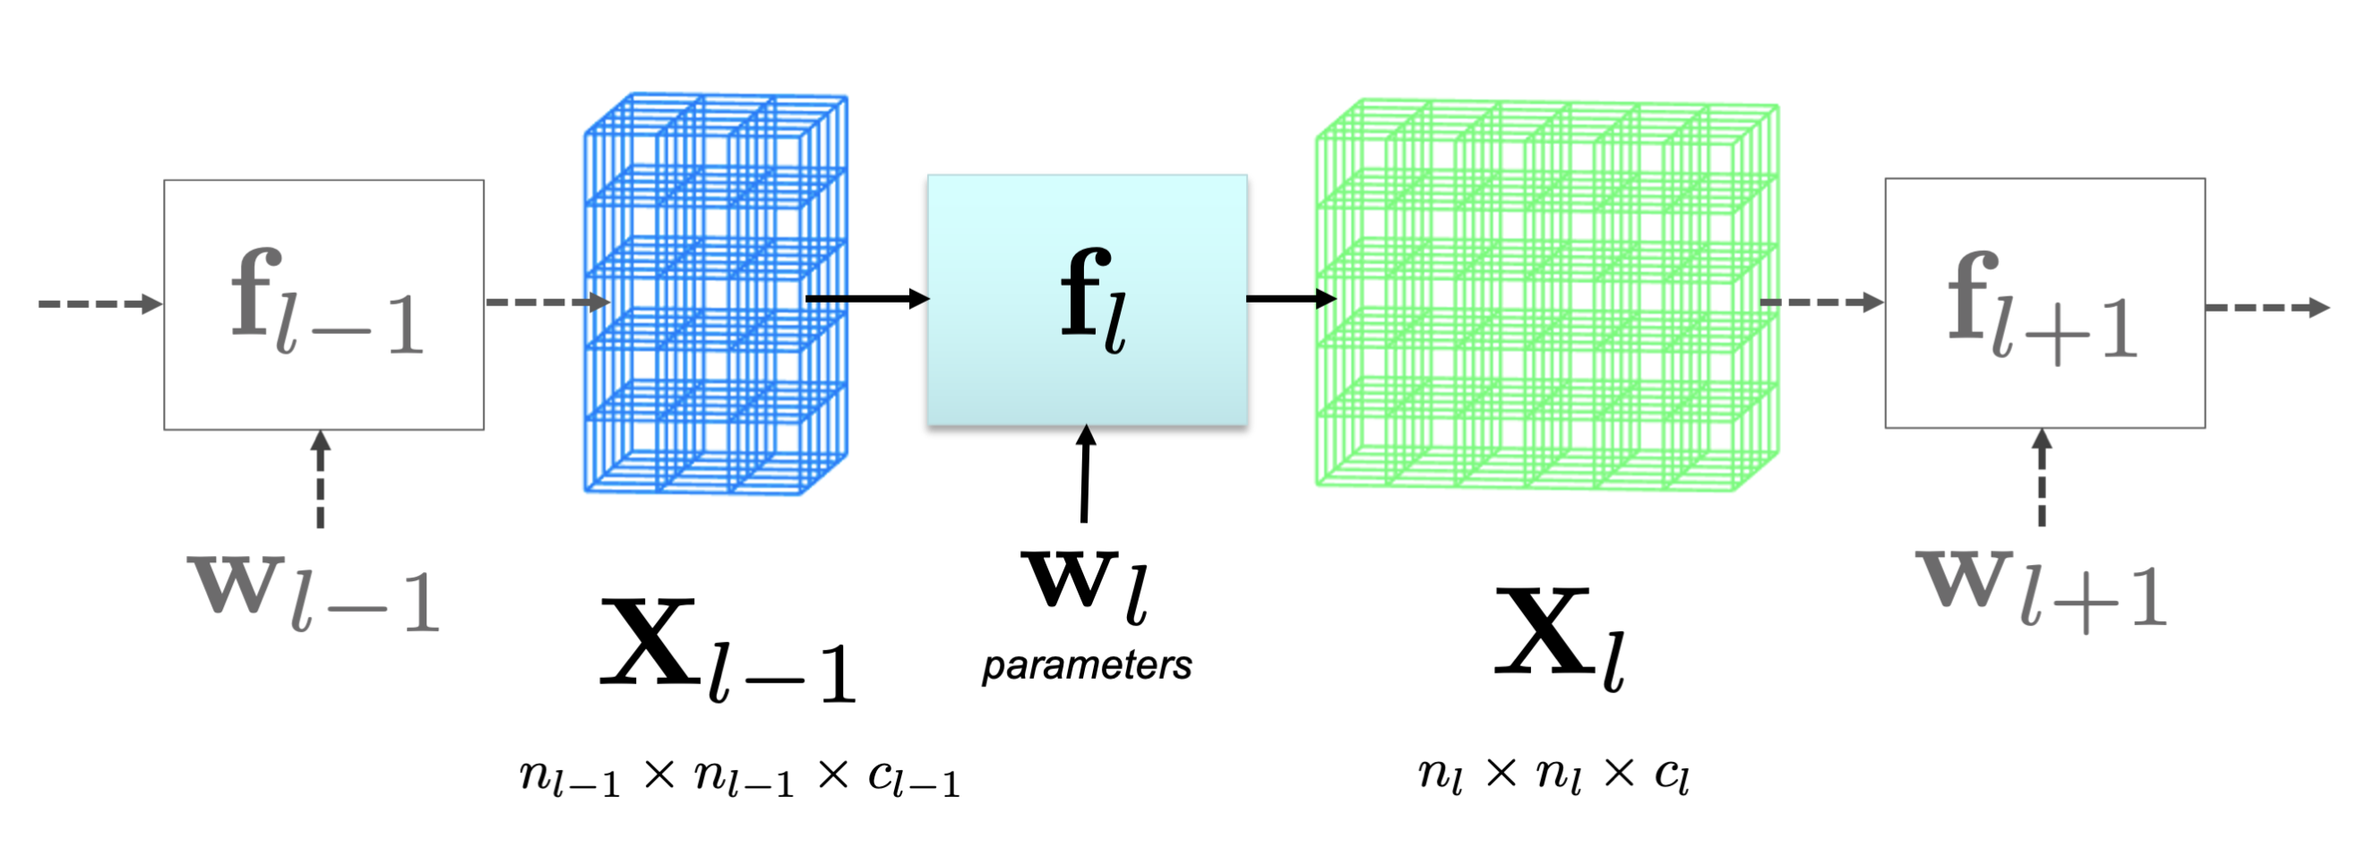
DEEP LEARNING BASICS

Slide 20
DEEP LEARNING: Typical layers
Convolution layer
Pooling layer
Rectified Linear Unit
Fully connected and SoftMax

Slide 21
DEEP LEARNING: Typical layers
Convolution layer
Pooling layer
Rectified Linear Unit
Fully connected and SoftMax

Slide 22
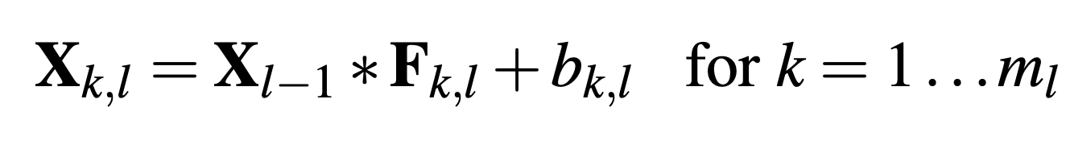
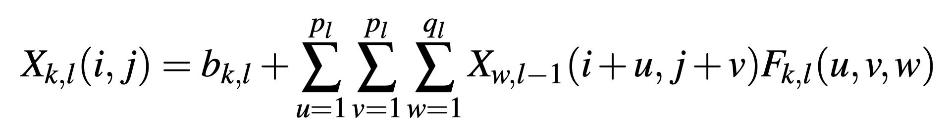
DEEP LEARNING: Convolution layer

Slide 23
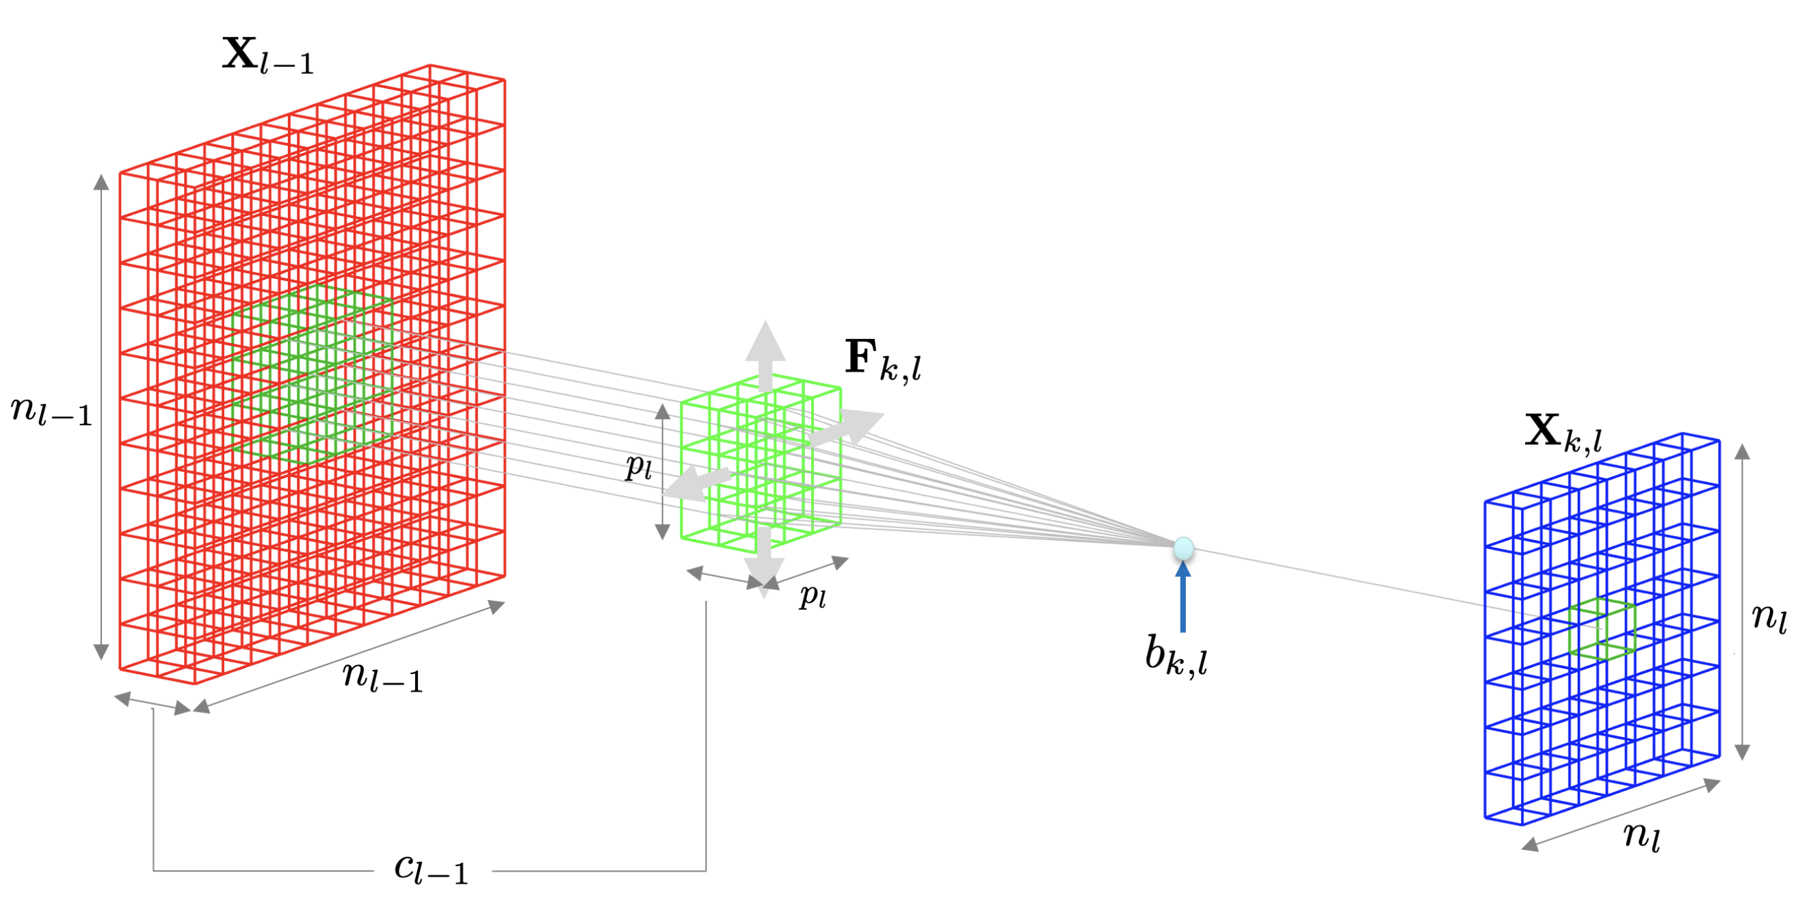
DEEP LEARNING: Convolution layer

Slide 24
DEEP LEARNING: Typical layers
Convolution layer
Pooling layer
Rectified Linear Unit
Fully connected and SoftMax

Slide 25
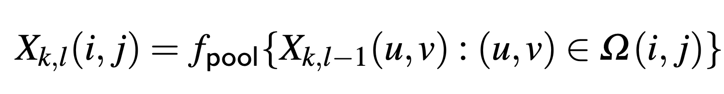
DEEP LEARNING: Pooling layer

Slide 26
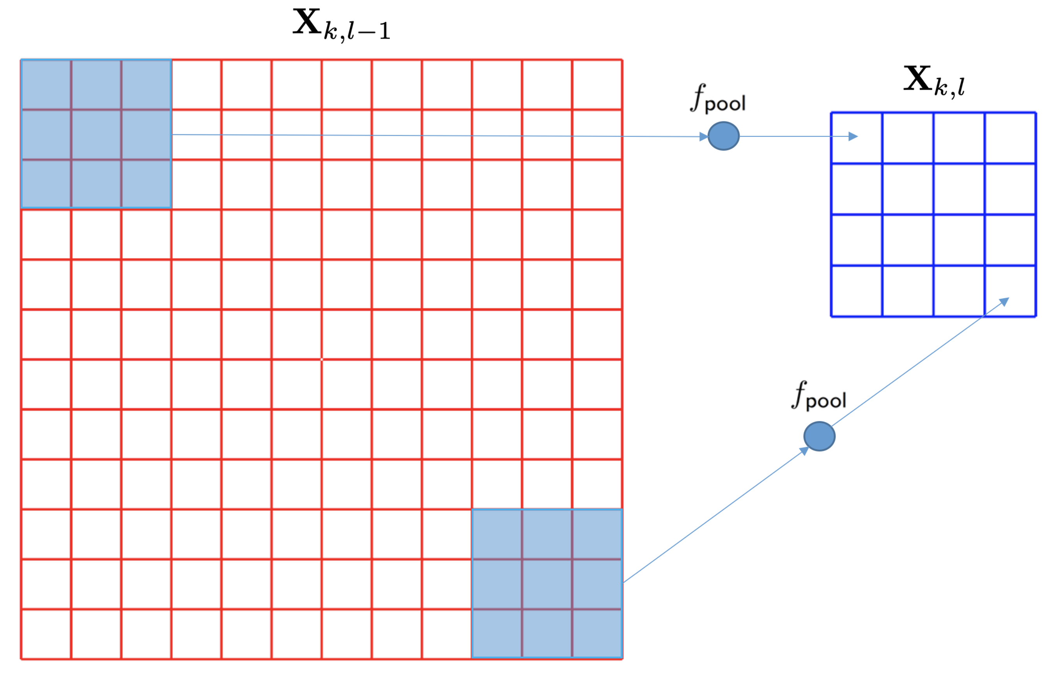
DEEP LEARNING: Pooling layer

Slide 27
DEEP LEARNING: Typical layers
Convolution layer
Pooling layer
Rectified Linear Unit
Fully connected and SoftMax

Slide 28
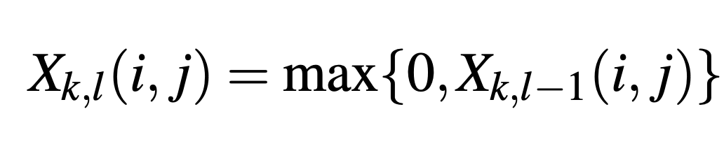
DEEP LEARNING: Rectified Linear Unit (ReLU)

Slide 29
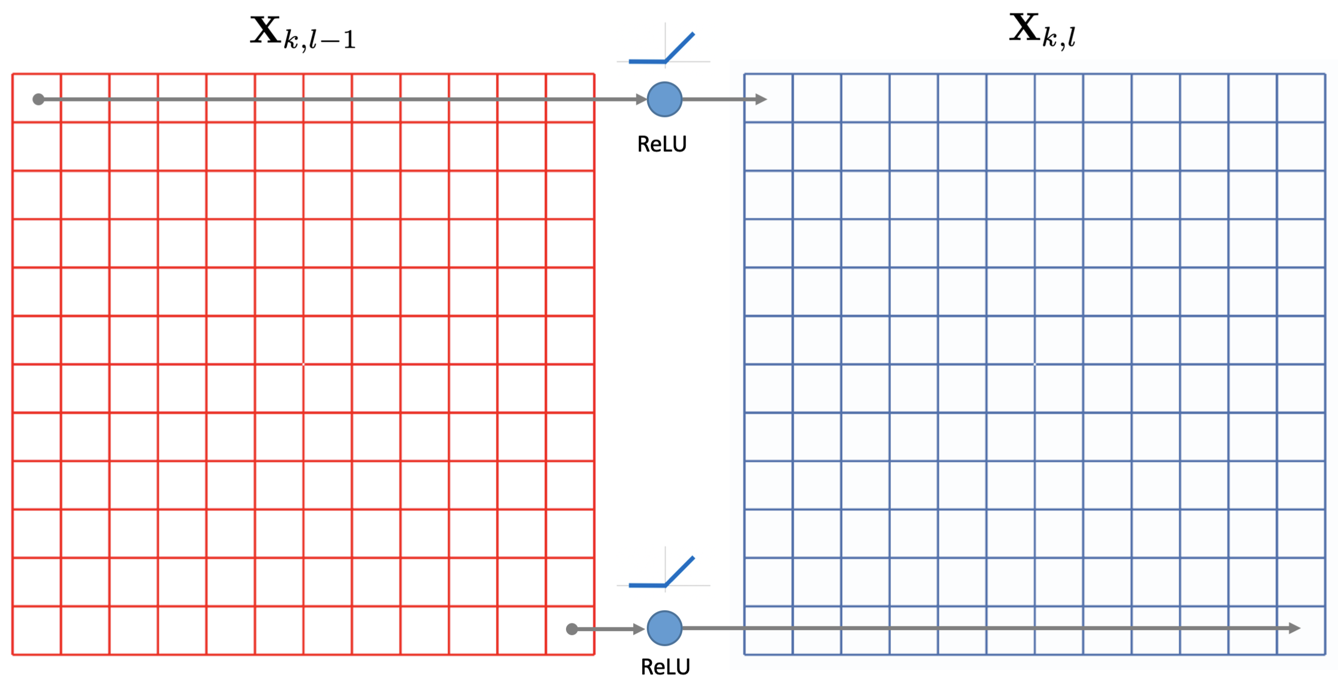
DEEP LEARNING: Rectified Linear Unit (ReLU)

Slide 30
DEEP LEARNING: Typical layers
Convolution layer
Pooling layer
Rectified Linear Unit
Fully connected and SoftMax

Slide 31
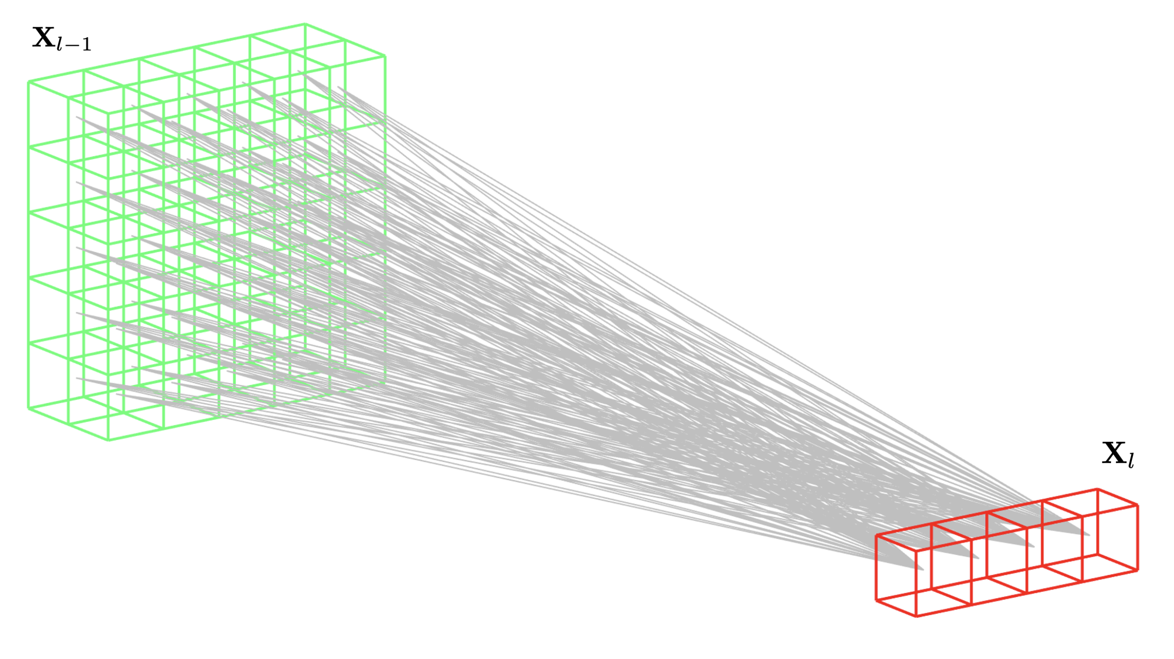
DEEP LEARNING: Fully Connected

Slide 32
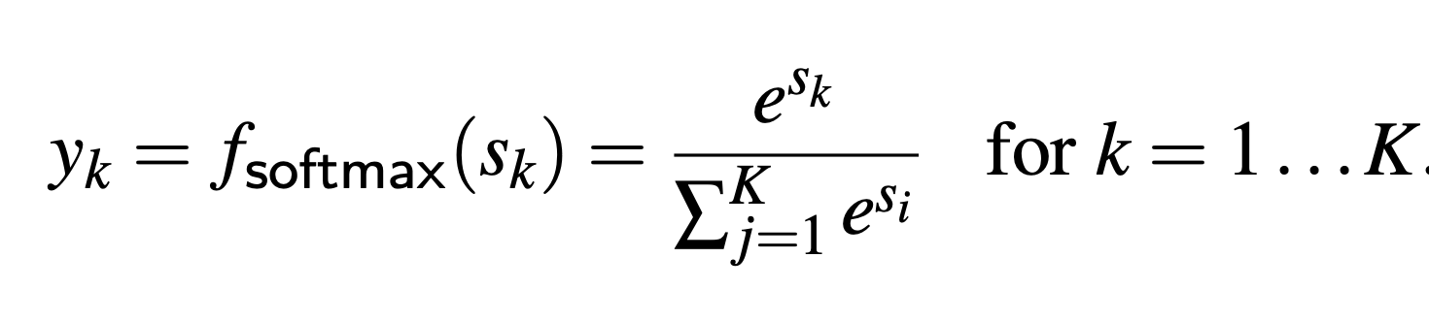
DEEP LEARNING: Fully Connected + SoftMax

Slide 33
Training

Slide 34
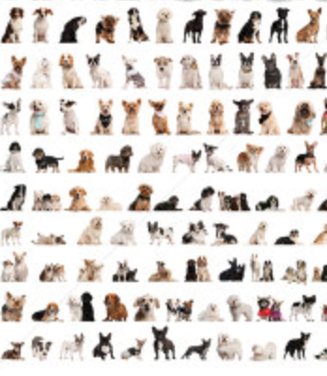


DEEP LEARNING: Training
dogs
errors
cats
Back-propagation

Slide 35
Example
Eyes vs. Nose Recognizer

Slide 36
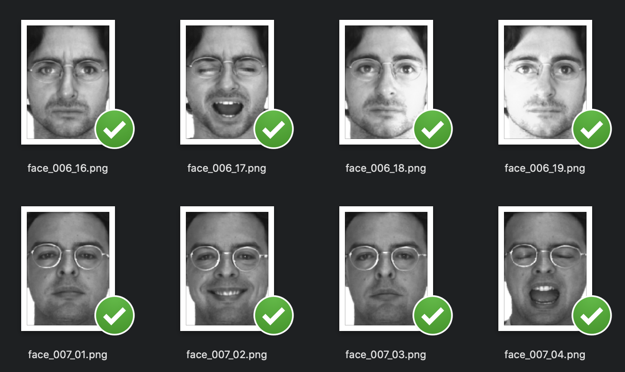
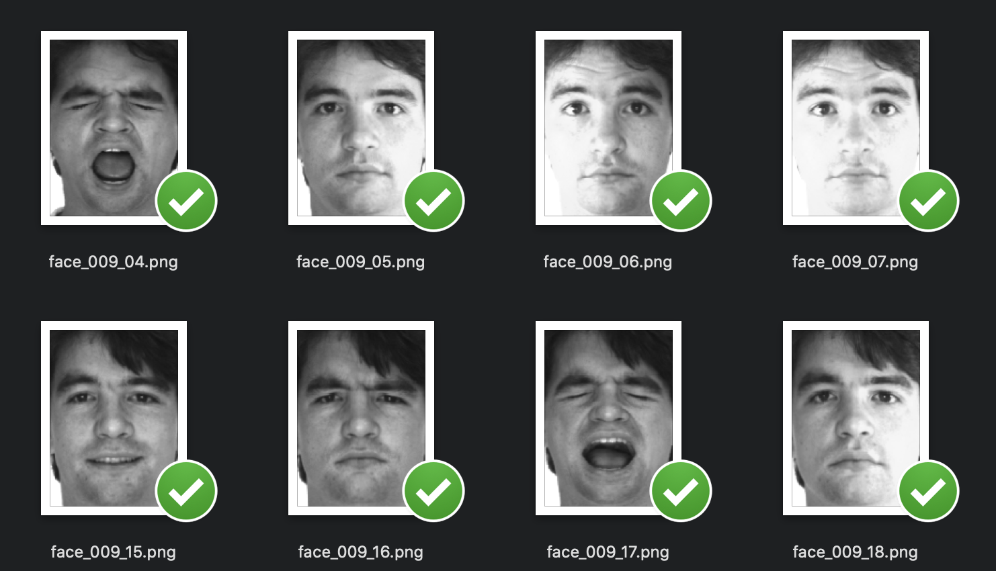

Slide 37
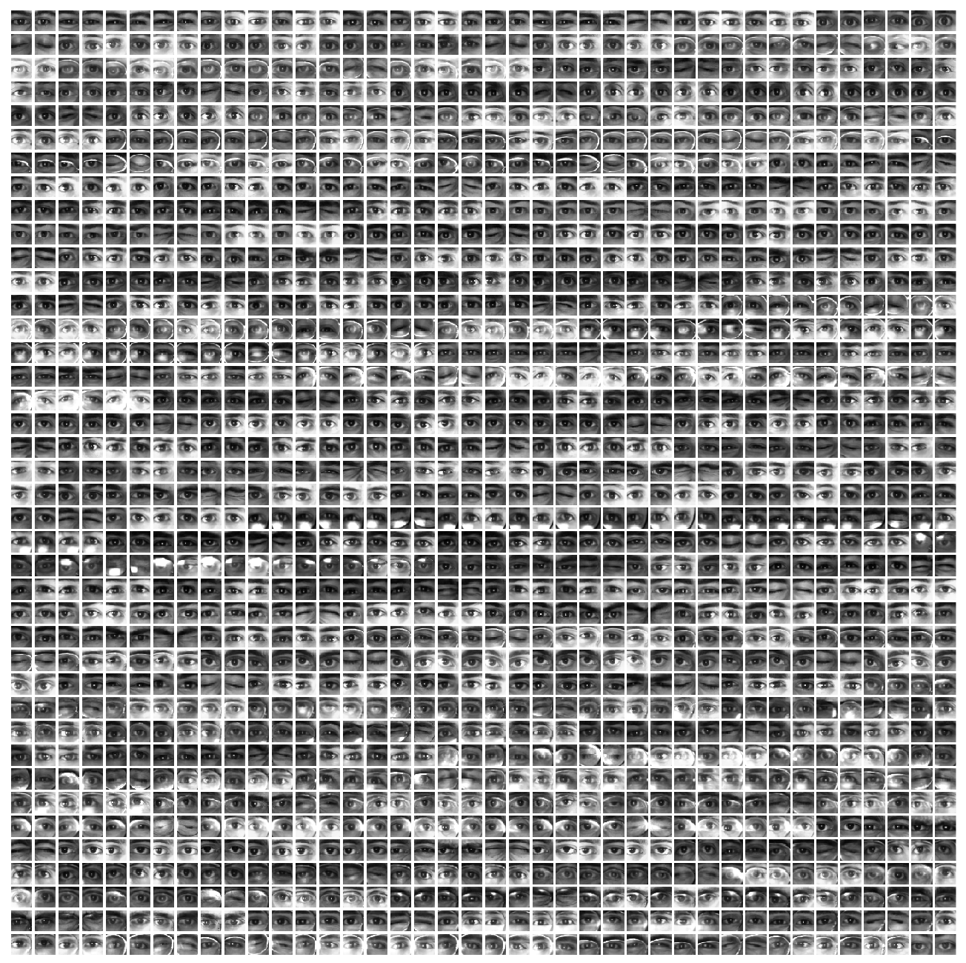
Eyes

Slide 38
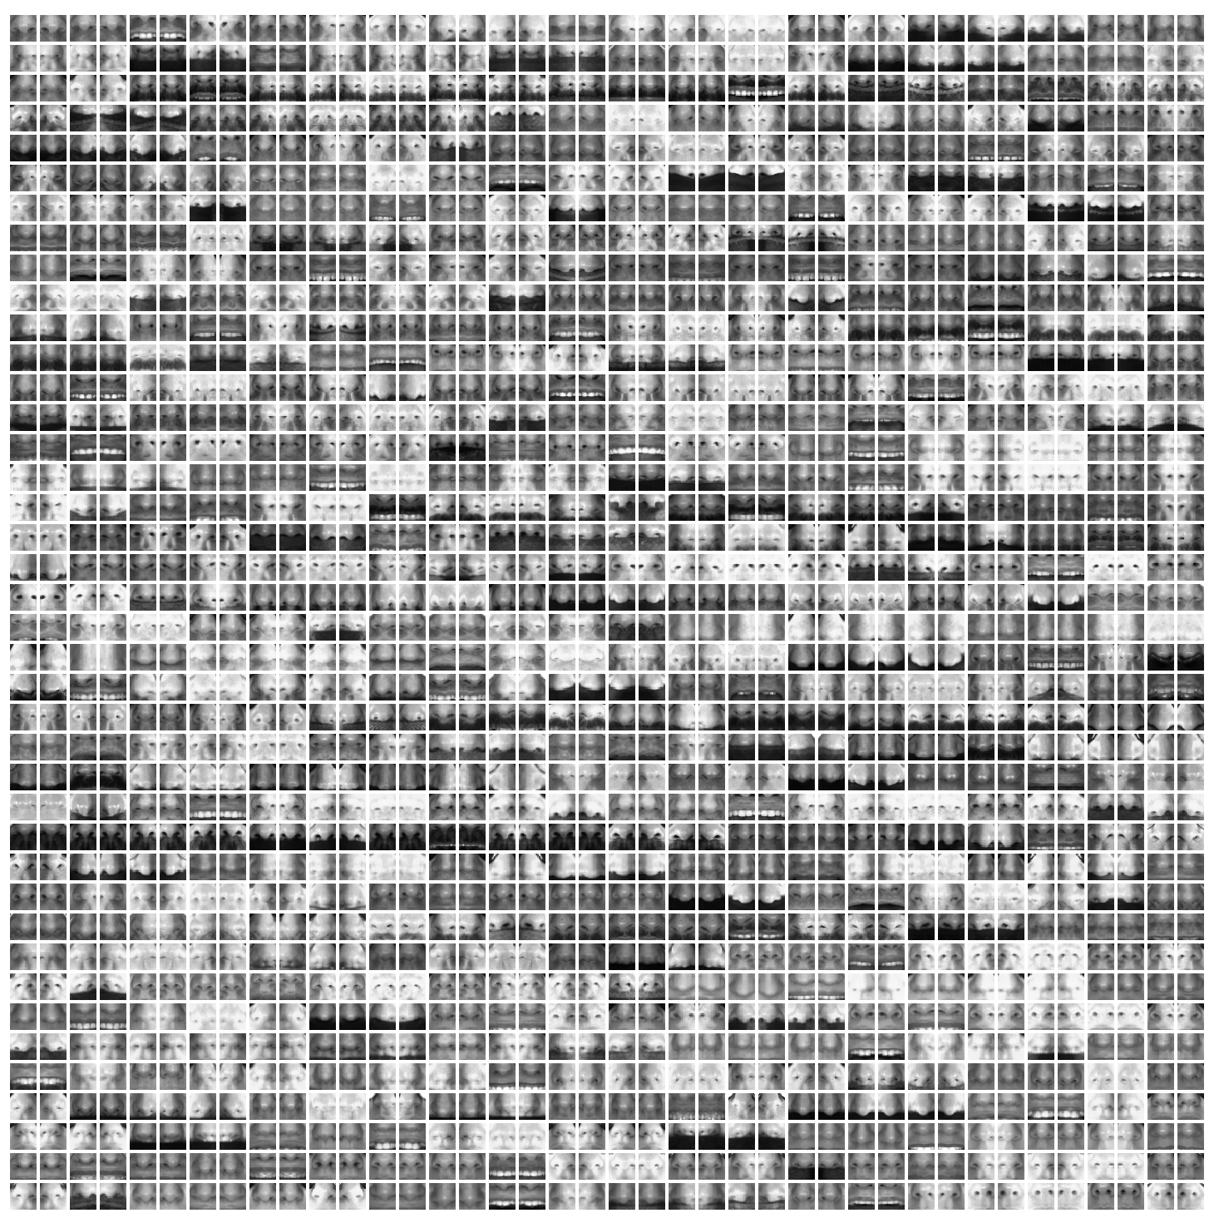
Noses

Slide 39
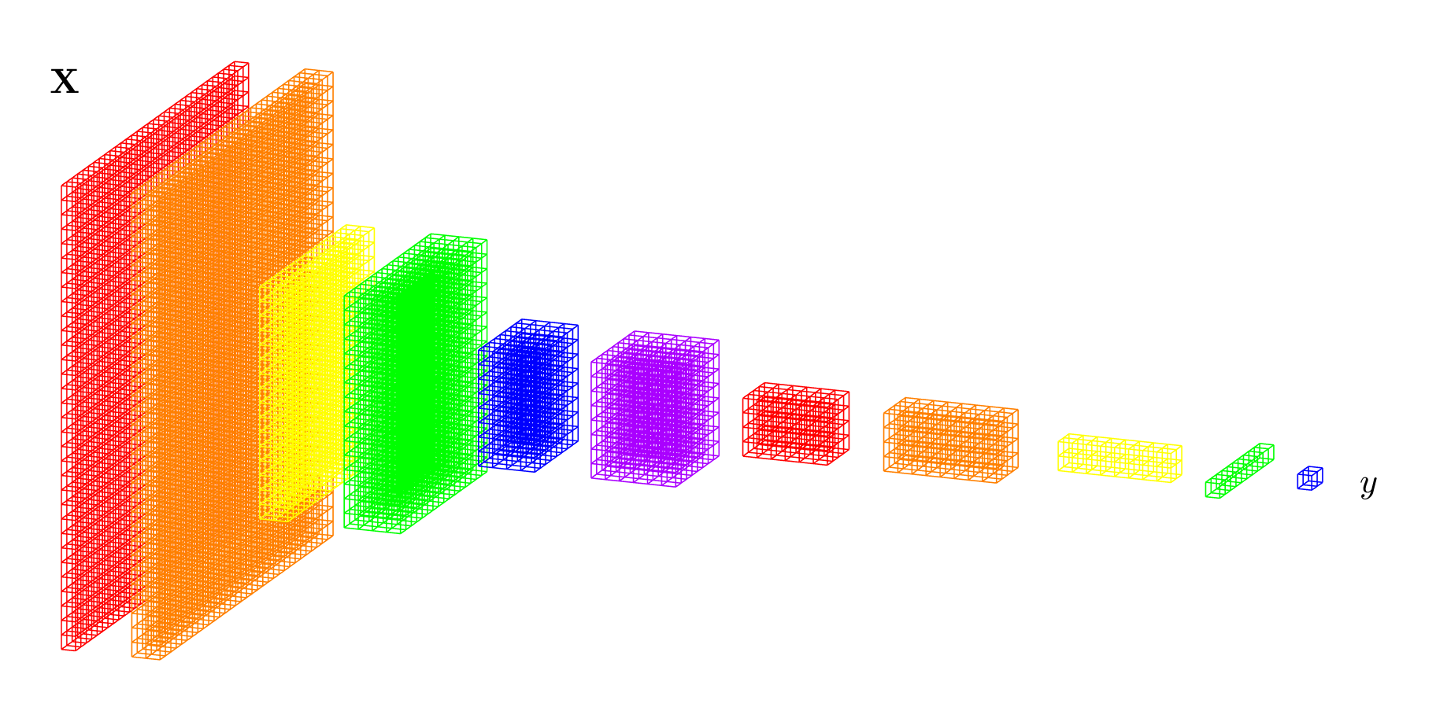

Slide 40
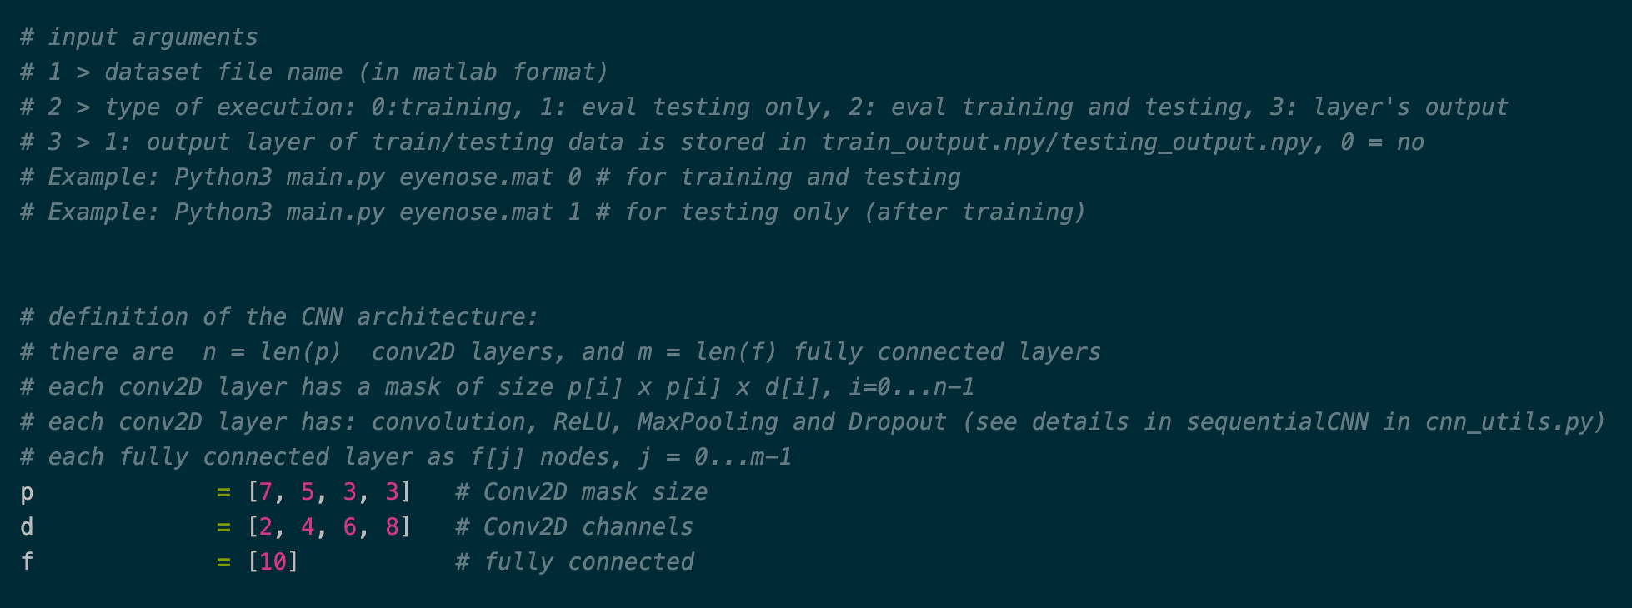
conv2D: 7x7x2 + ReLU + MaxPool + Dropout
5x5x4 + ReLU + MaxPool + Dropout
3x3x6 + ReLU + MaxPool + Dropout
3x3x8 + ReLU + MaxPool + Dropout
fc: 10
+
fc+softmax 2

Slide 41
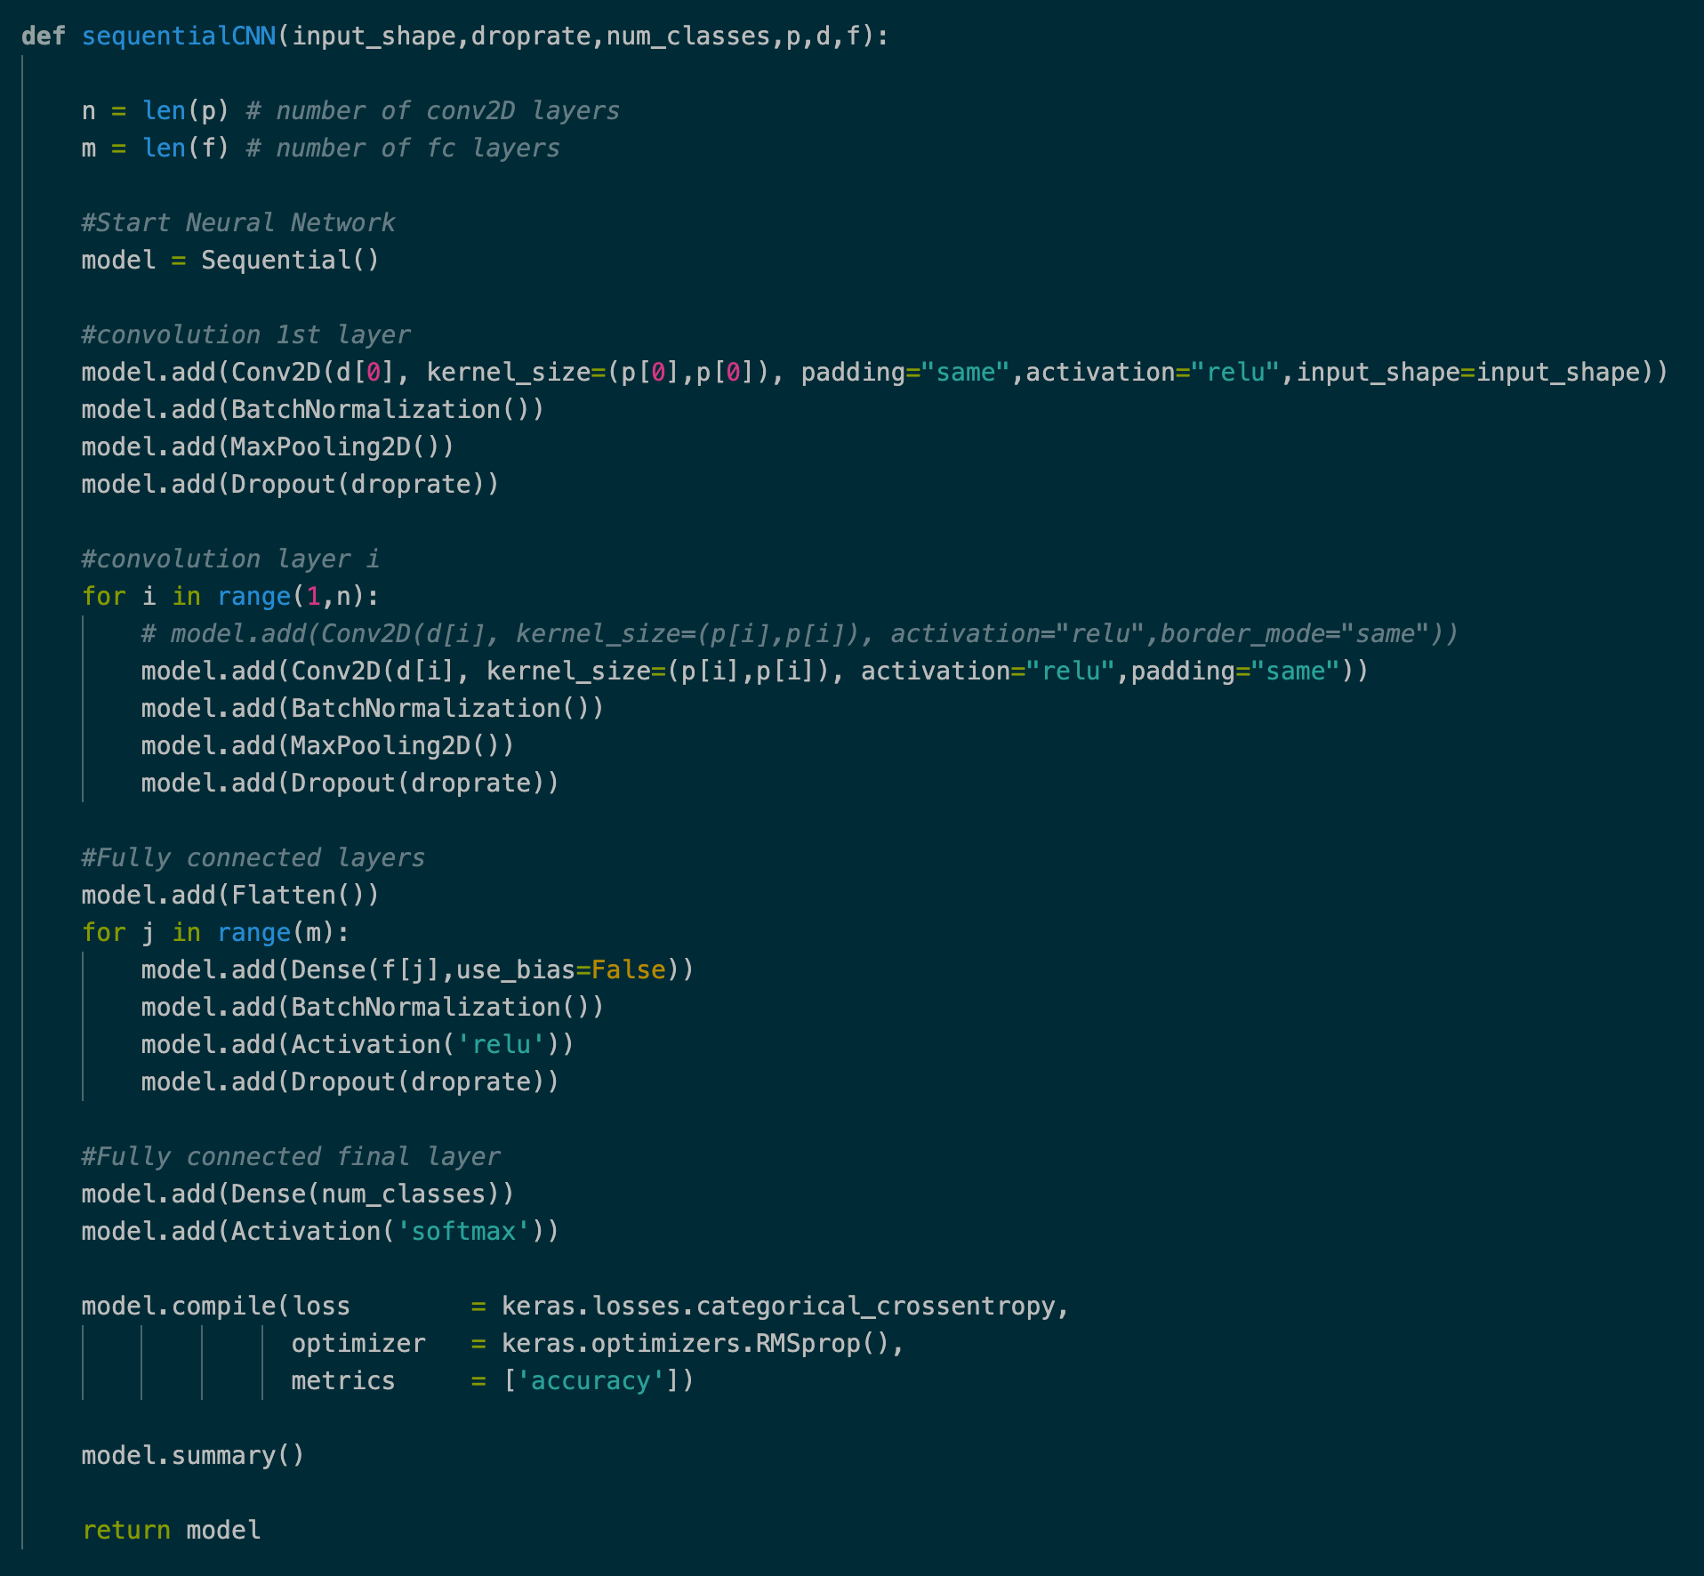

Slide 42
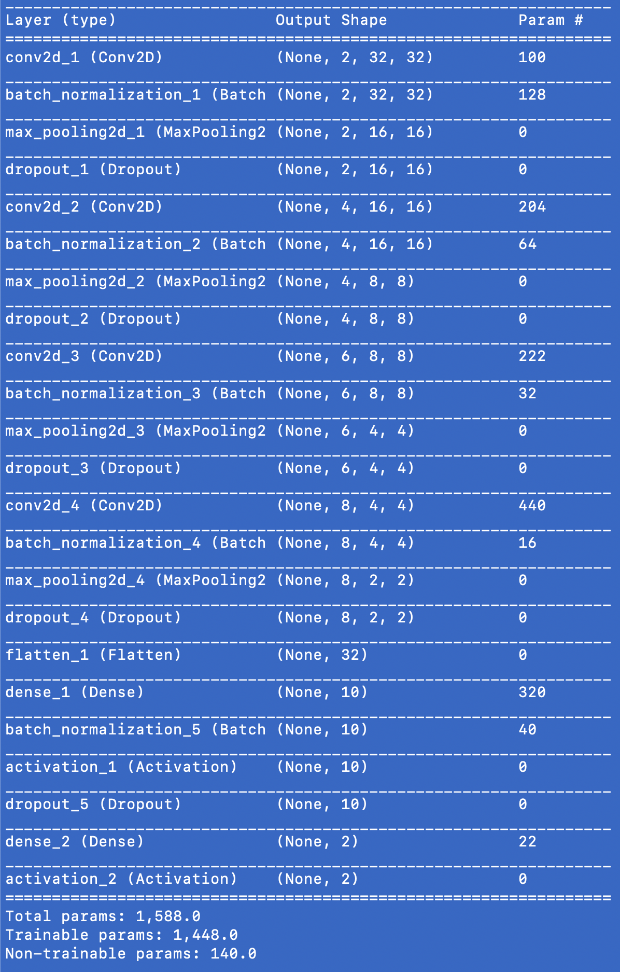

Slide 43
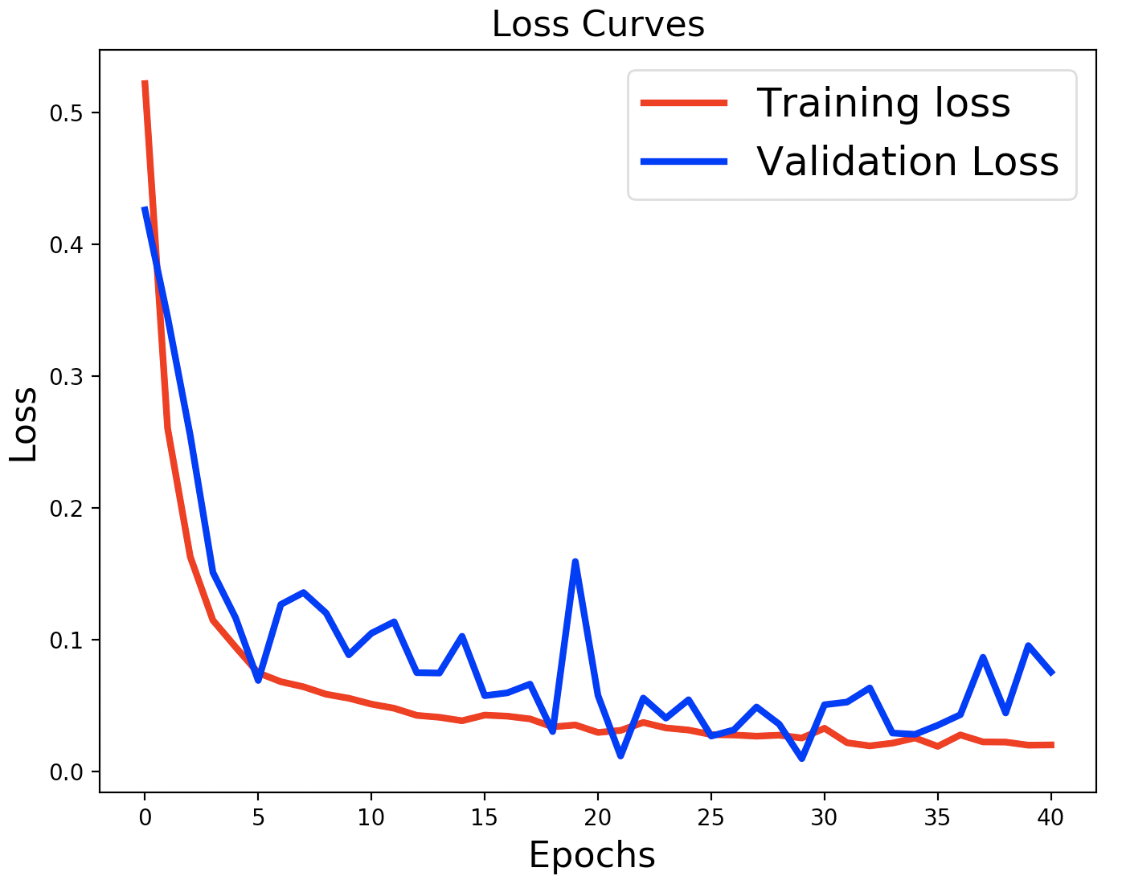
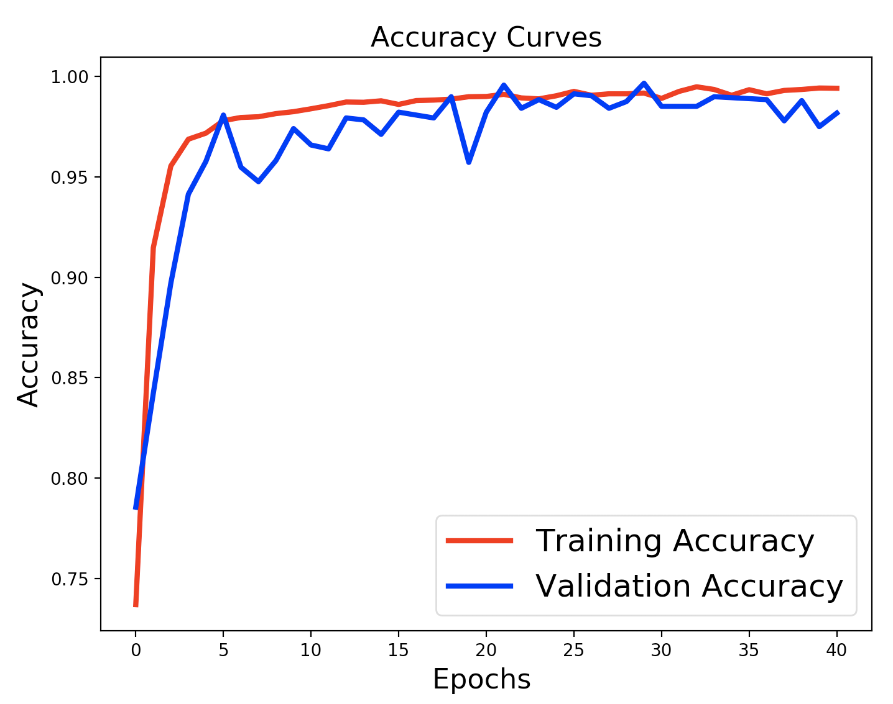

Slide 44
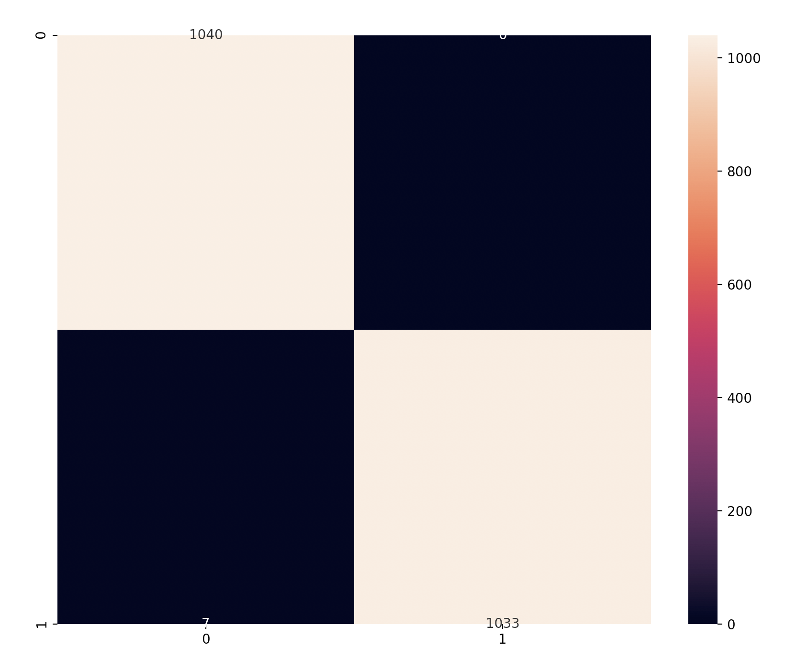
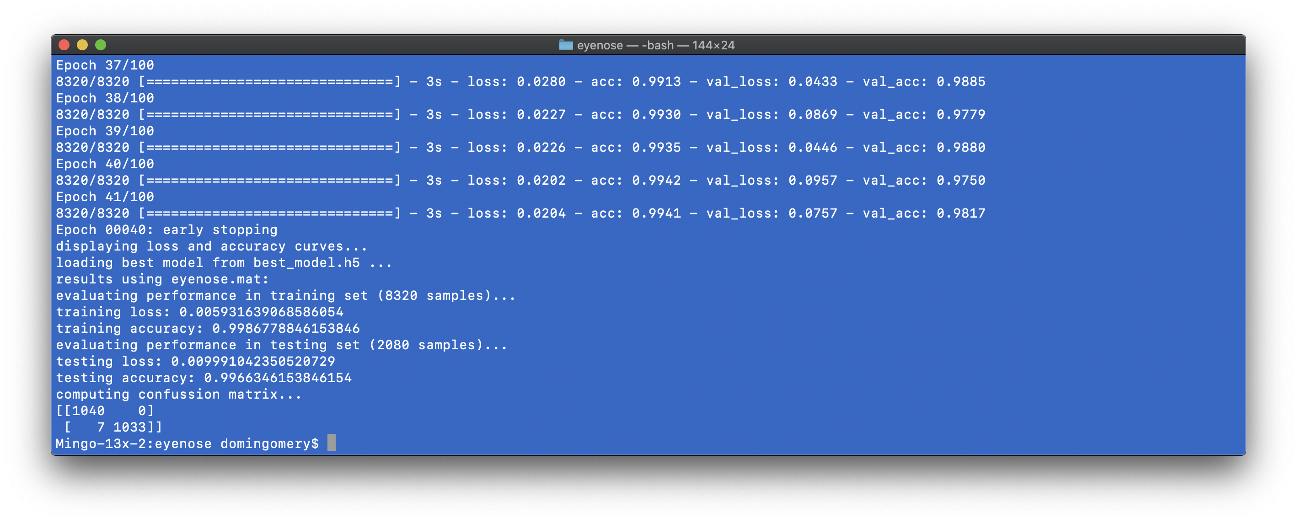
1040
0
Acc = 99.66%
7
1033

Slide 45
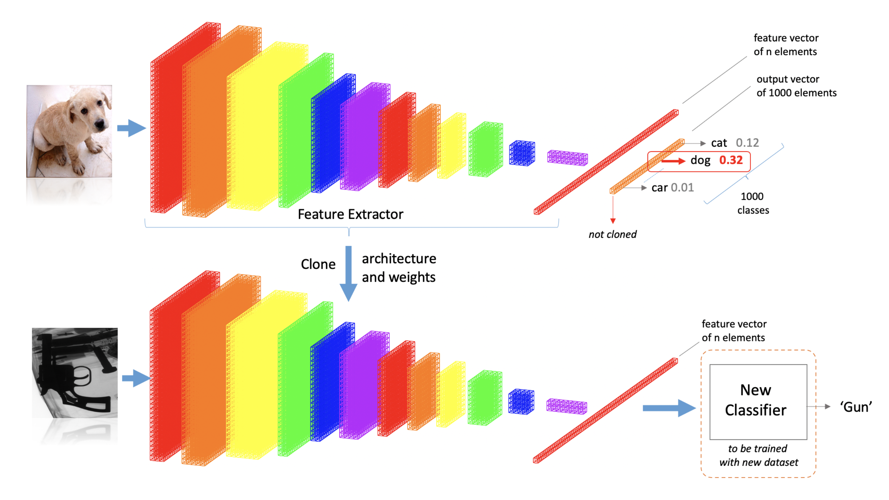
Pre-Trained Models

Slide 46
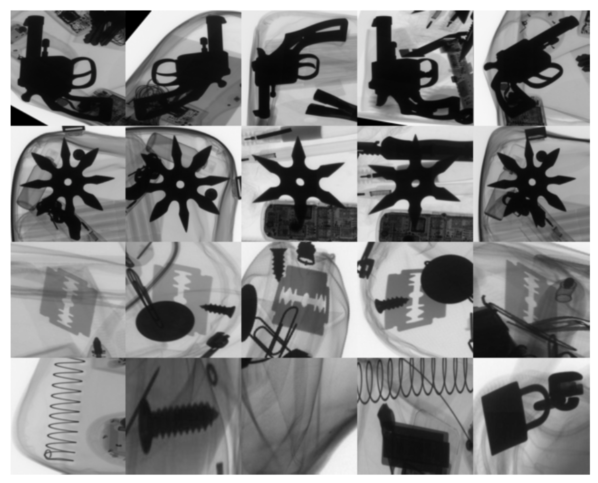

Slide 47
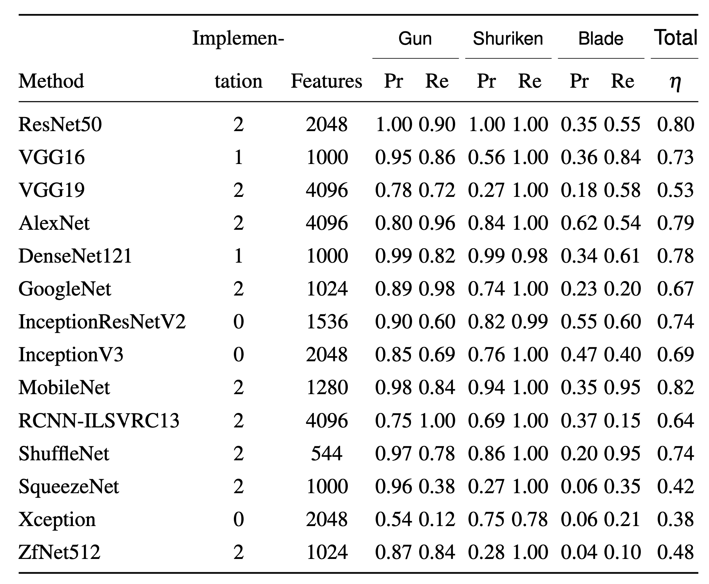

Slide 48
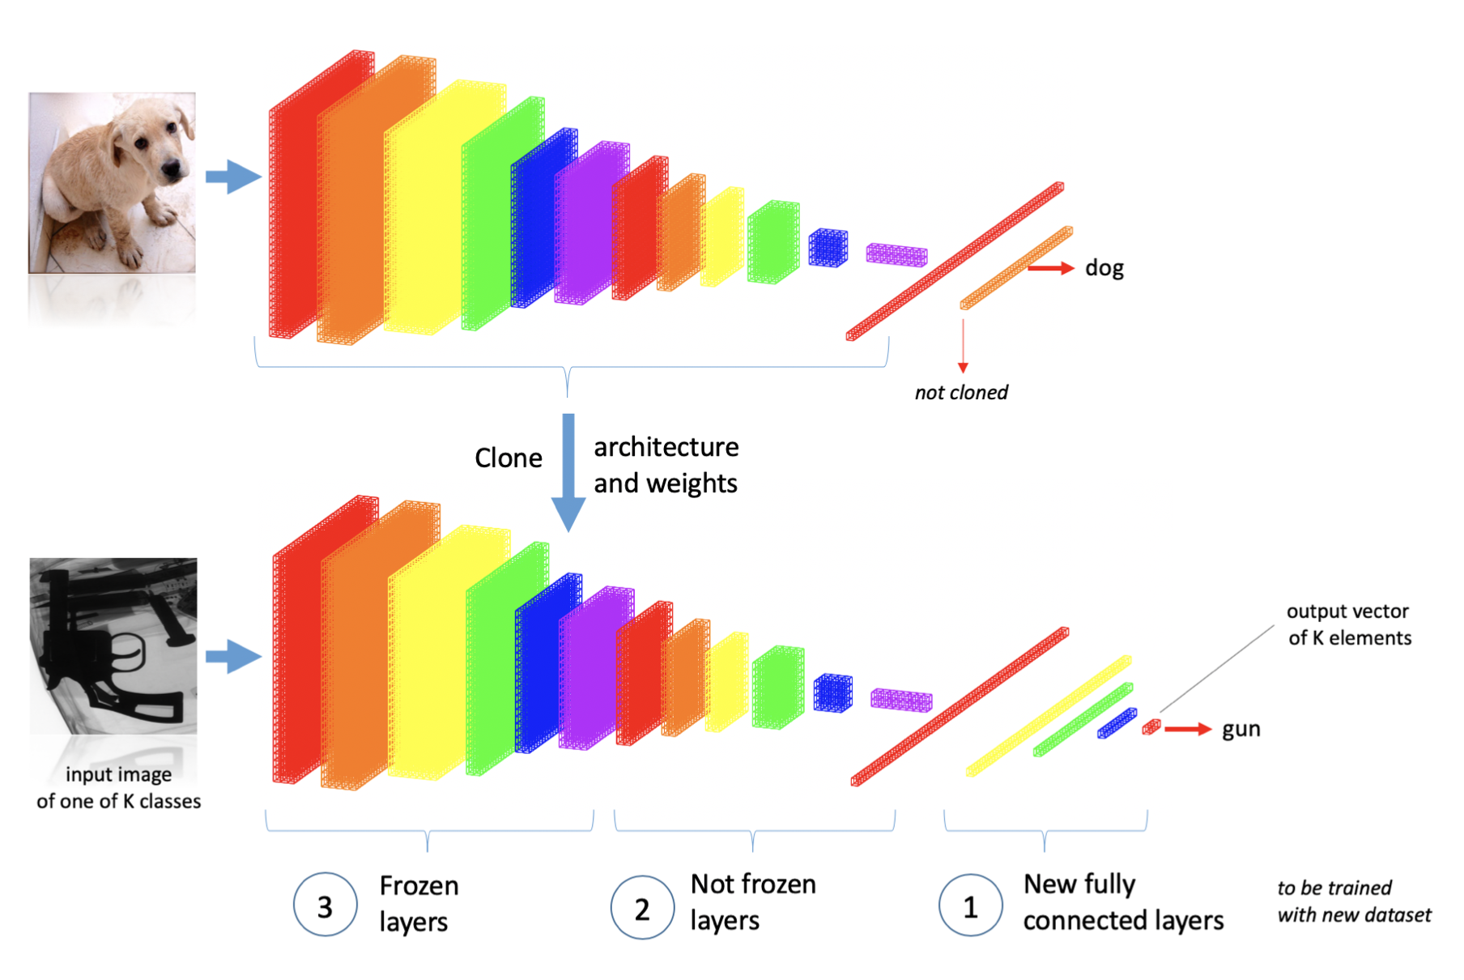
Transfer Learning

Slide 49
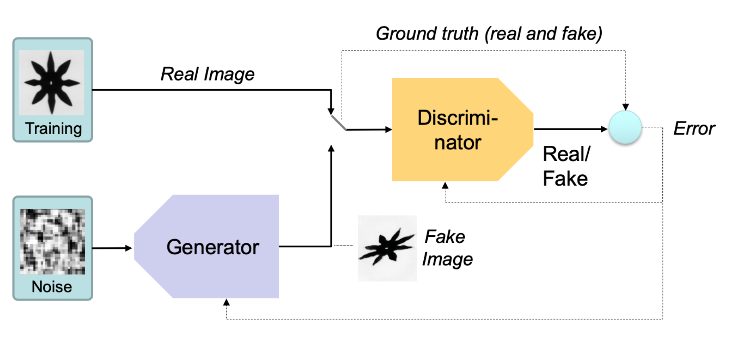
GAN: Generative Adversarial Networks

Slide 50
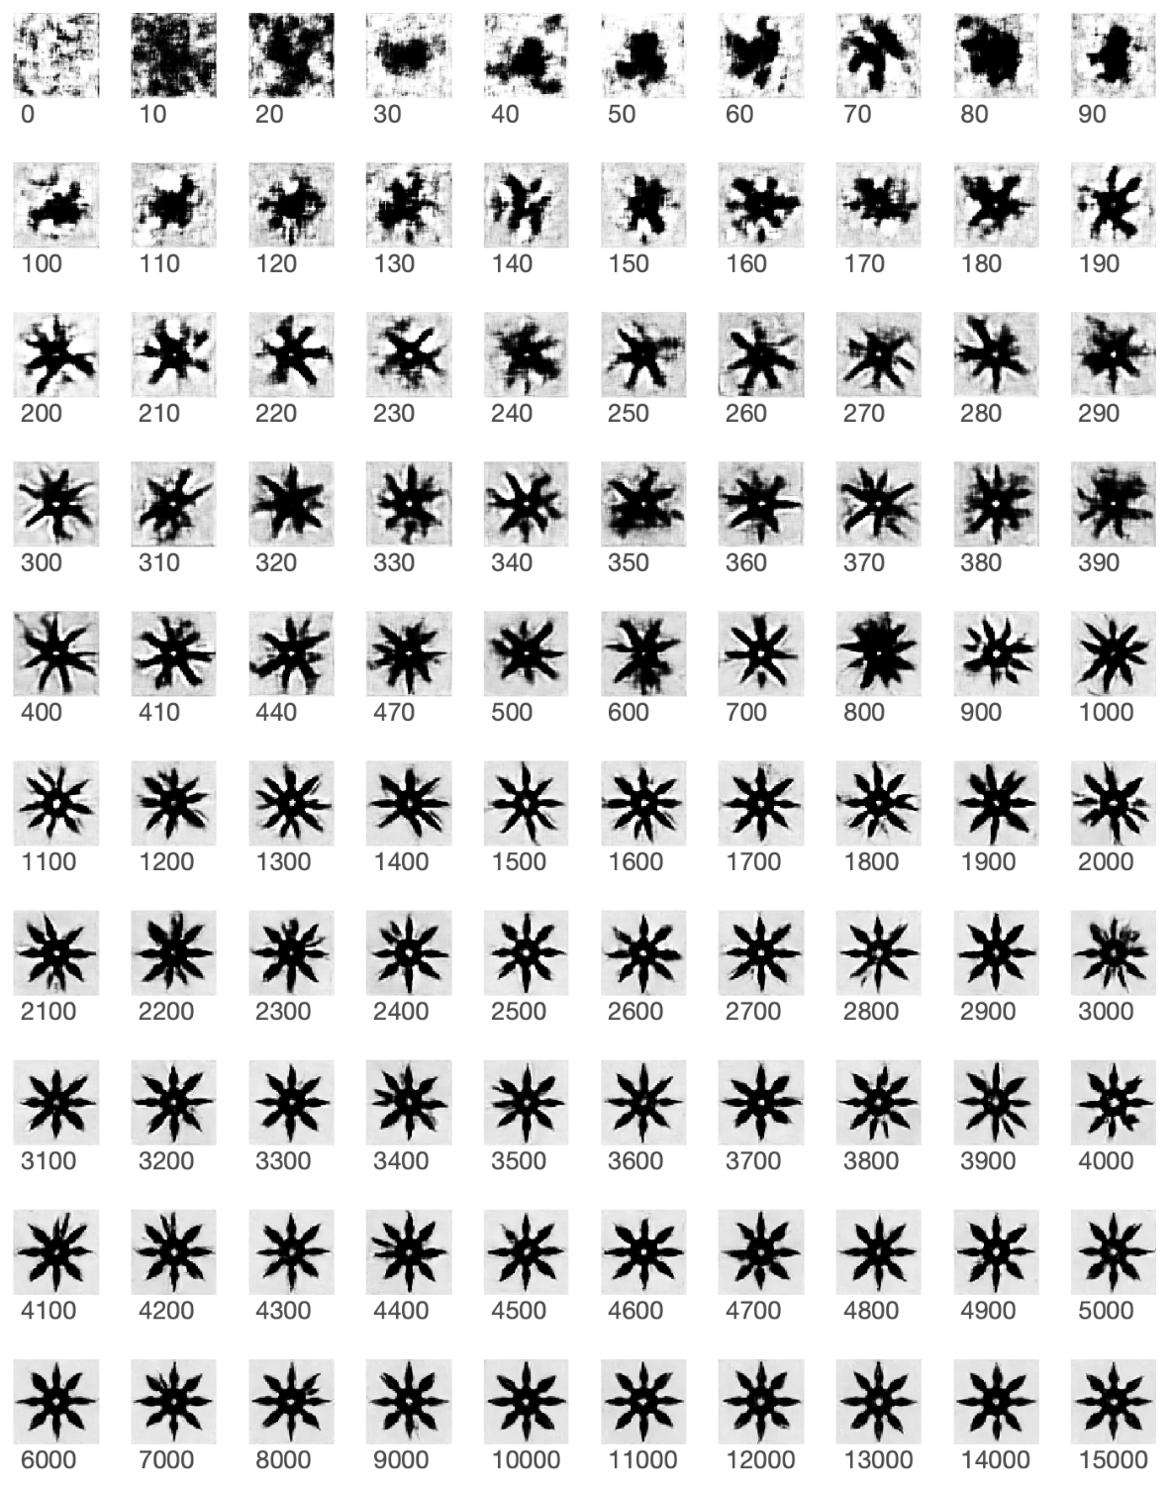
GAN: Shuriken

Slide 51
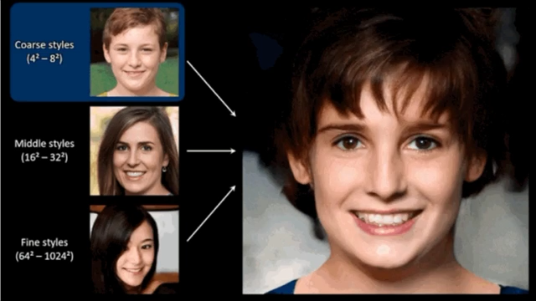
GAN: Generative Adversarial Networks
https://syncedreview.com/2019/02/09/nvidia-open-sources-hyper-realistic-face-generator-stylegan/

Slide 52
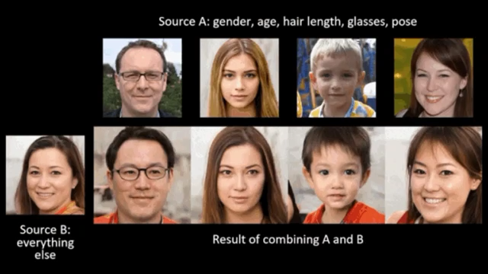
GAN: Generative Adversarial Networks
https://syncedreview.com/2019/02/09/nvidia-open-sources-hyper-realistic-face-generator-stylegan/

Slide 53
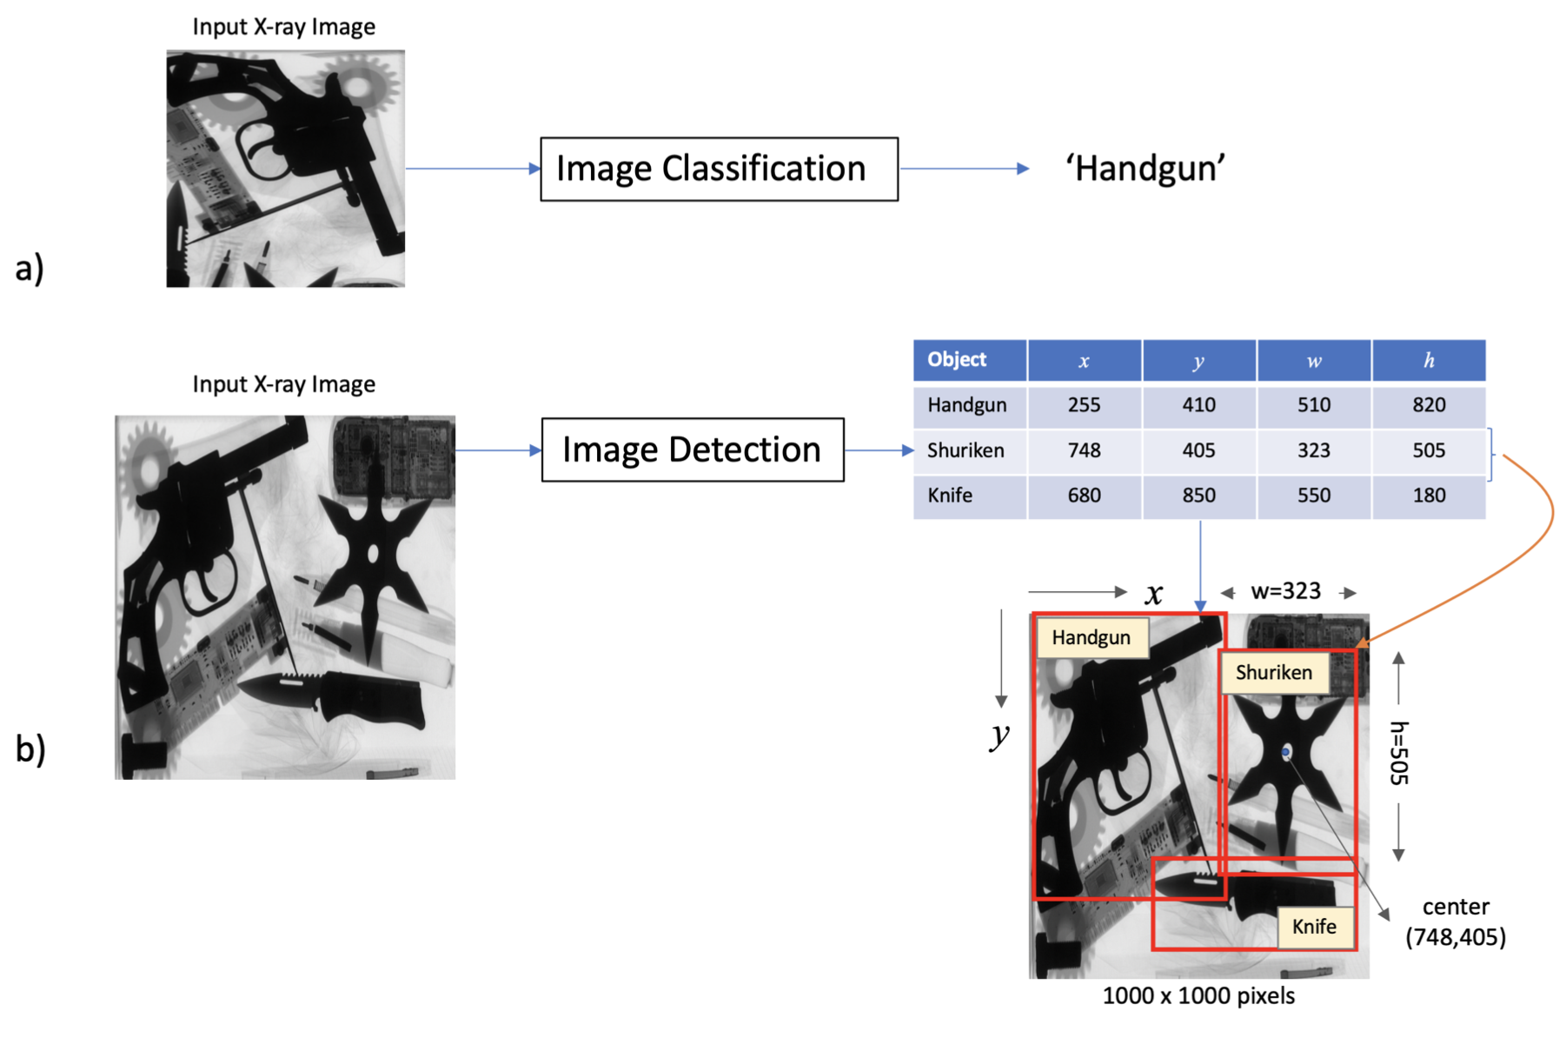
Image Classification vs. Image Detection

Slide 54
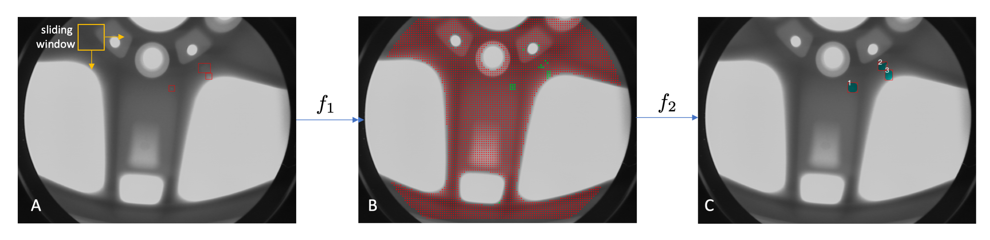
Image Detection: Sliding Windows

Slide 55
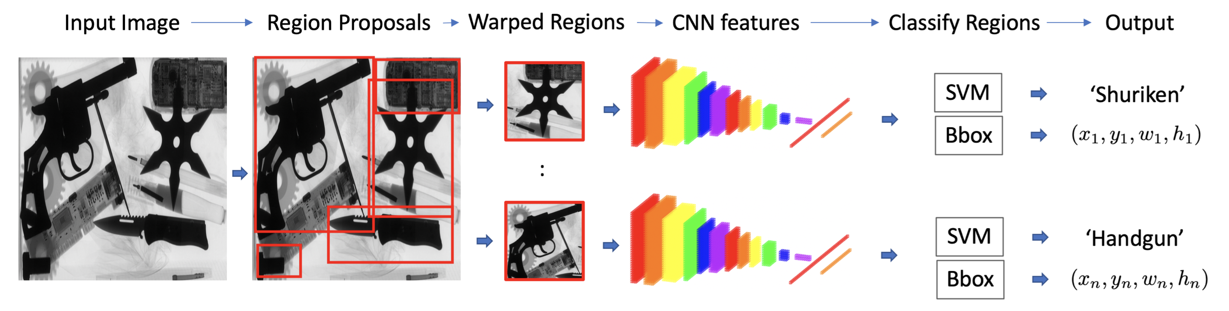
Image Detection: R-CNN

Slide 56
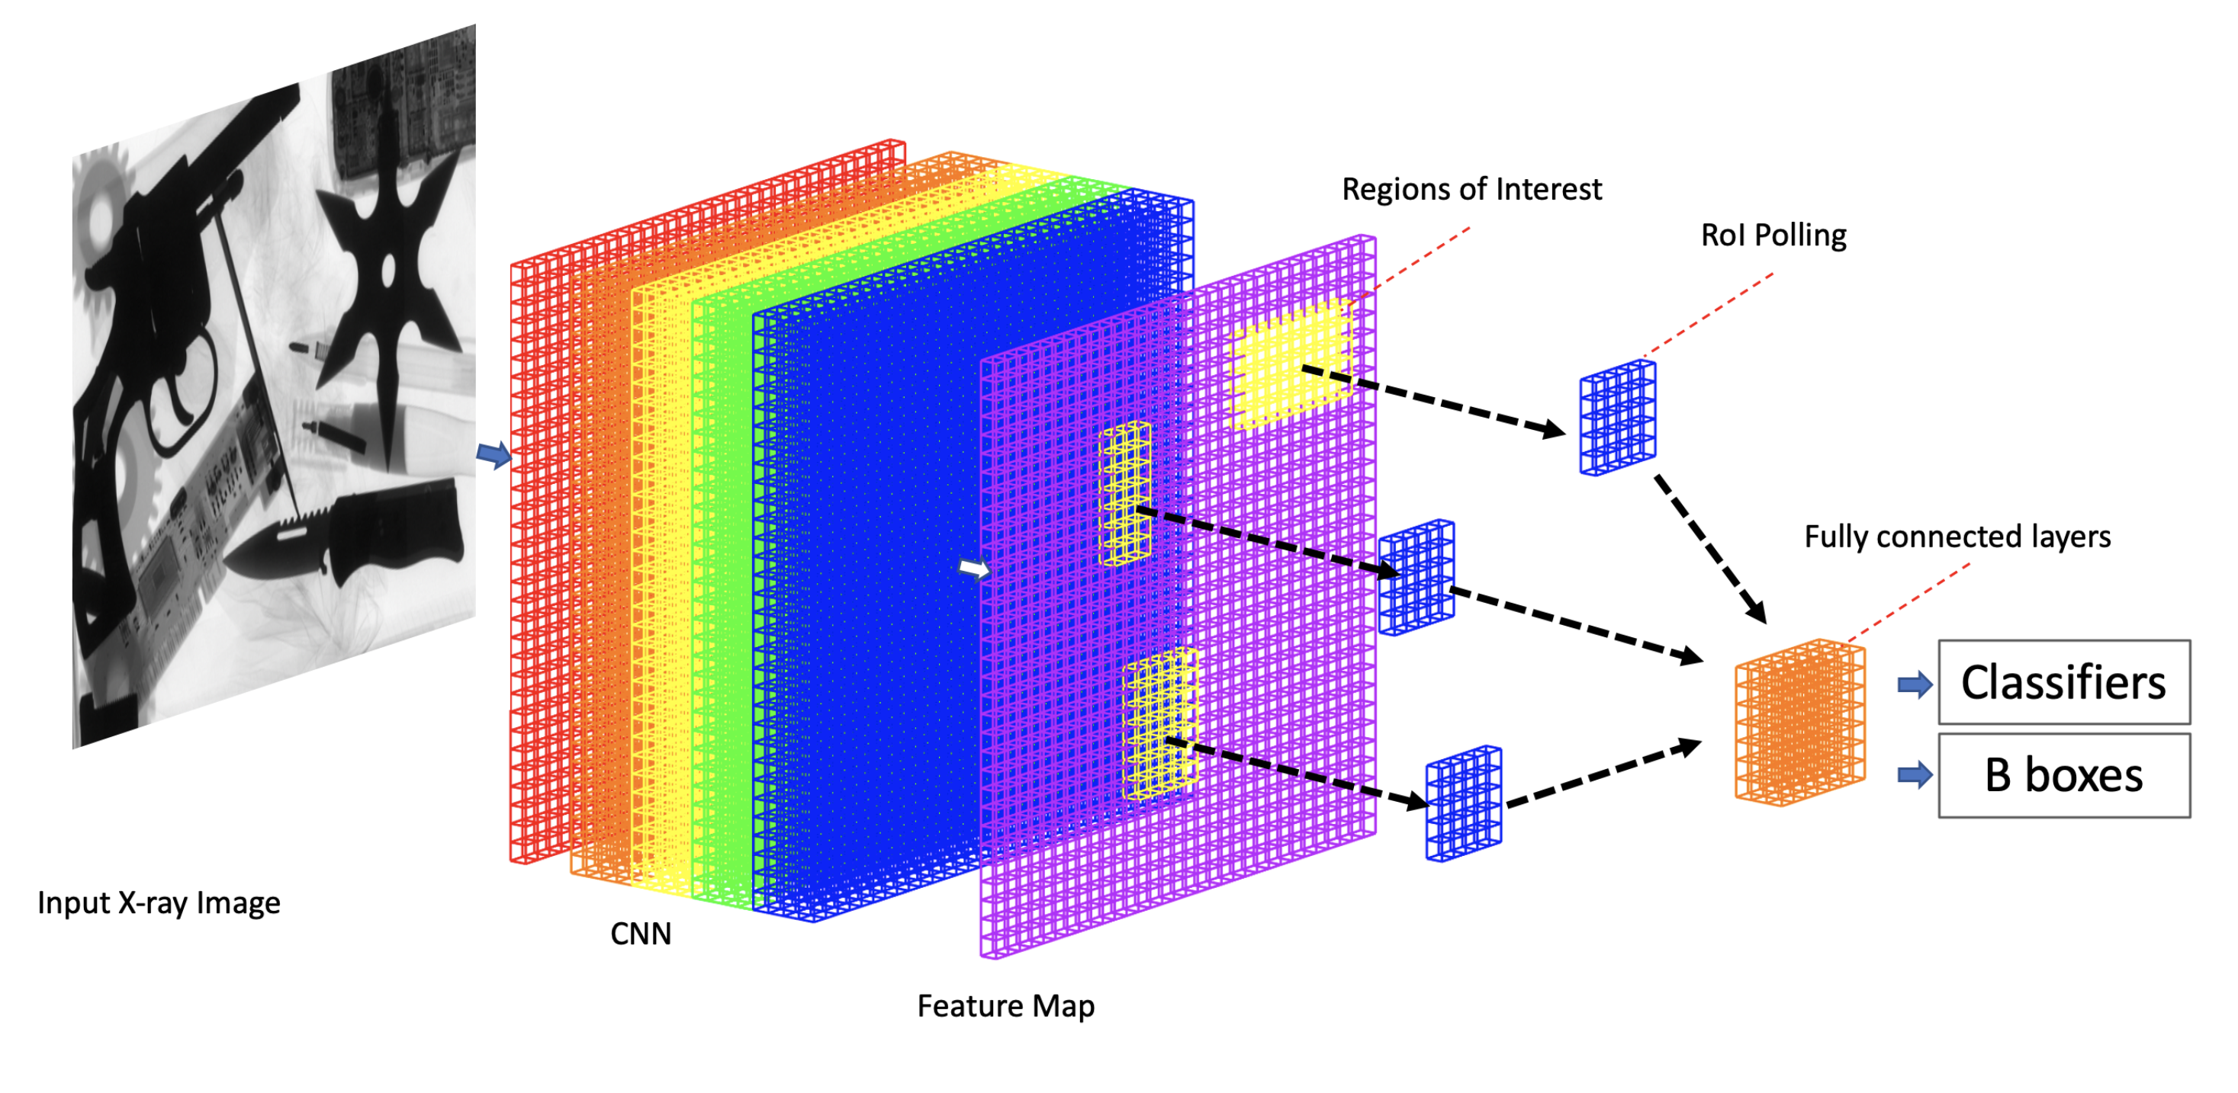
Image Detection: Fast R-CNN

Slide 57

Image Detection: Faster R-CNN and Mask R-CNN

Slide 58

Image Detection: YOLO

Slide 59


Slide 60


